Slide 1


Reasons Why Manufacturers Trust NetSuite Over Microsoft & Other ERP Solutions

Slide 2
Reasons Why Manufacturers Trust NetSuite
NetSuite is a cloud-based business management platform used by more than 28,000 companies globally. It manages core functions, including finance and accounting, inventory, orders and procurement. All of these modules share a common database. This gives a real-time, 360° view of the business. Customers can also add CRM for sales, marketing automation, human resources for personnel records, performance management and payroll to plan and track projects for both online and in-store sales.

Slide 3
Reasons Why Manufacturers Trust NetSuite
Business Wide Integration
Simpler to upgrade Netsuite ERP
Easily Scalable

Slide 4

Unified Business View
NetSuite empowers the firm to run its entire business from a single platform. It brings together finance, manufacturing, supply chain, HR and ecommerce on one system, with one database.

Slide 5

Native Integrations
All NetSuite applications feed information into, and pull it from, the central database to ensure there’s only one source of knowledge.This unified architecture delivers a common user interface across all modules; that decreases training time and gets people productive faster.

Slide 6

Reporting Capabilities
NetSuite also has role-based dashboards that quickly give employees, managers and executives the information they need to make informed decisions. The vast amount of data flowing from departments and business units into the NetSuite platform fuels its extensive reporting capabilities.

Slide 7

Flexibility
NetSuite can serve a broad array of industries not only because it comes with impressive functionality, but because it can adapt to meet the requirements of different businesses. The platform can be customized to accommodate your processes and corporate structure through SuiteCloud apps and tools.

Slide 8
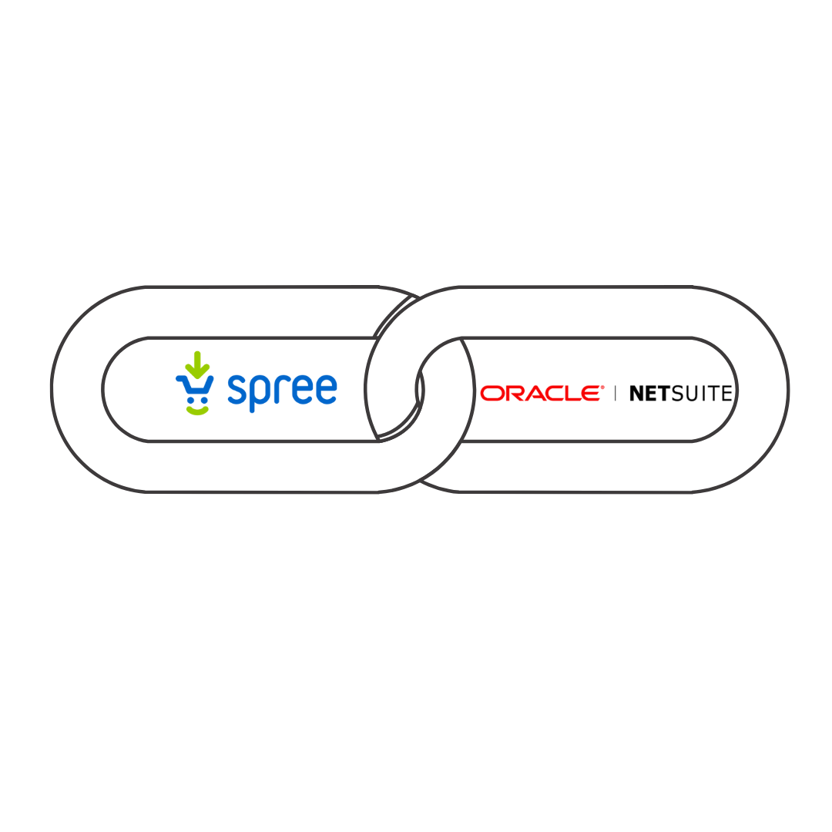

eCommerce
Need an expert for NetSuite Manufacturing Business Solutions?
Drop us your query at netsuite.sales@folio3.com.

Slide 9
Thank You
netsuite.sales@folio3.com
netsuite.folio3.com
Head Office:
1301 Shoreway Road,
Suite 160,
Belmont, CA 94002, USA
Surrey, United Kingdom
Dubai, UAE
Sofia, Bulgaria
Lahore & Karachi, Pakistan
Pleasanton, California
Chicago, Illinois
Toronto, Canada
Guadalajara, Mexico

