Slide 1
How NetSuite Integration Grows Your Business

Slide 2
Agenda
NetSuite Integration
Custom-made Integration
Why You Should Integrate Them Into Your Systems
Choosing Your Partners
How do Folio3’s connectors Facilitate Your Growth?

Slide 3
NetSuite Integration
NetSuite integration, a SaaS software solution, combines ERP, CRM and ecommerce packages into a single package.

Slide 4
Custom-made Integration
NetSuite can be integrated with existing platforms and applications to provide a fully connected business environment.
Integrate applications ranging in scope from order processing and EDI to standalone CRM applications such as Salesforce, Amazon, or other eCommerce platforms like eBay, Amazon, and more.

Slide 5
NetSuite Is Intelligent
To provide personalized and immediate access to important performance indicators, all business data can be stored in one database. It facilitates quick decision-making.
NetSuite Is Easy
NetSuite is able to implement all apps faster and more affordably than traditional corporate solutions.
NetSuite Is Integrated
It is a powerful and unique application. They integrate CRM-focused Customer and Ecommerce capabilities, as well as an accounting/ERP back office and a portal for partners. This allows firms to link disparate data and automate all operations.

Slide 6
Why You Should Integrate Them Into Your Systems?
More than 30,000 installations have been made for companies of different sizes and industries.

Slide 7
Cross-Organisational Efficiency
These procedures can be automated to reduce administrative, execution, invoicing and cash collection.

Slide 8
Enhances Visibility
To make informed decisions, it is important to have an immediate view. This information allows data extraction resources to be available from anywhere and at any moment. The procedures were speeded up and precise.

Slide 9
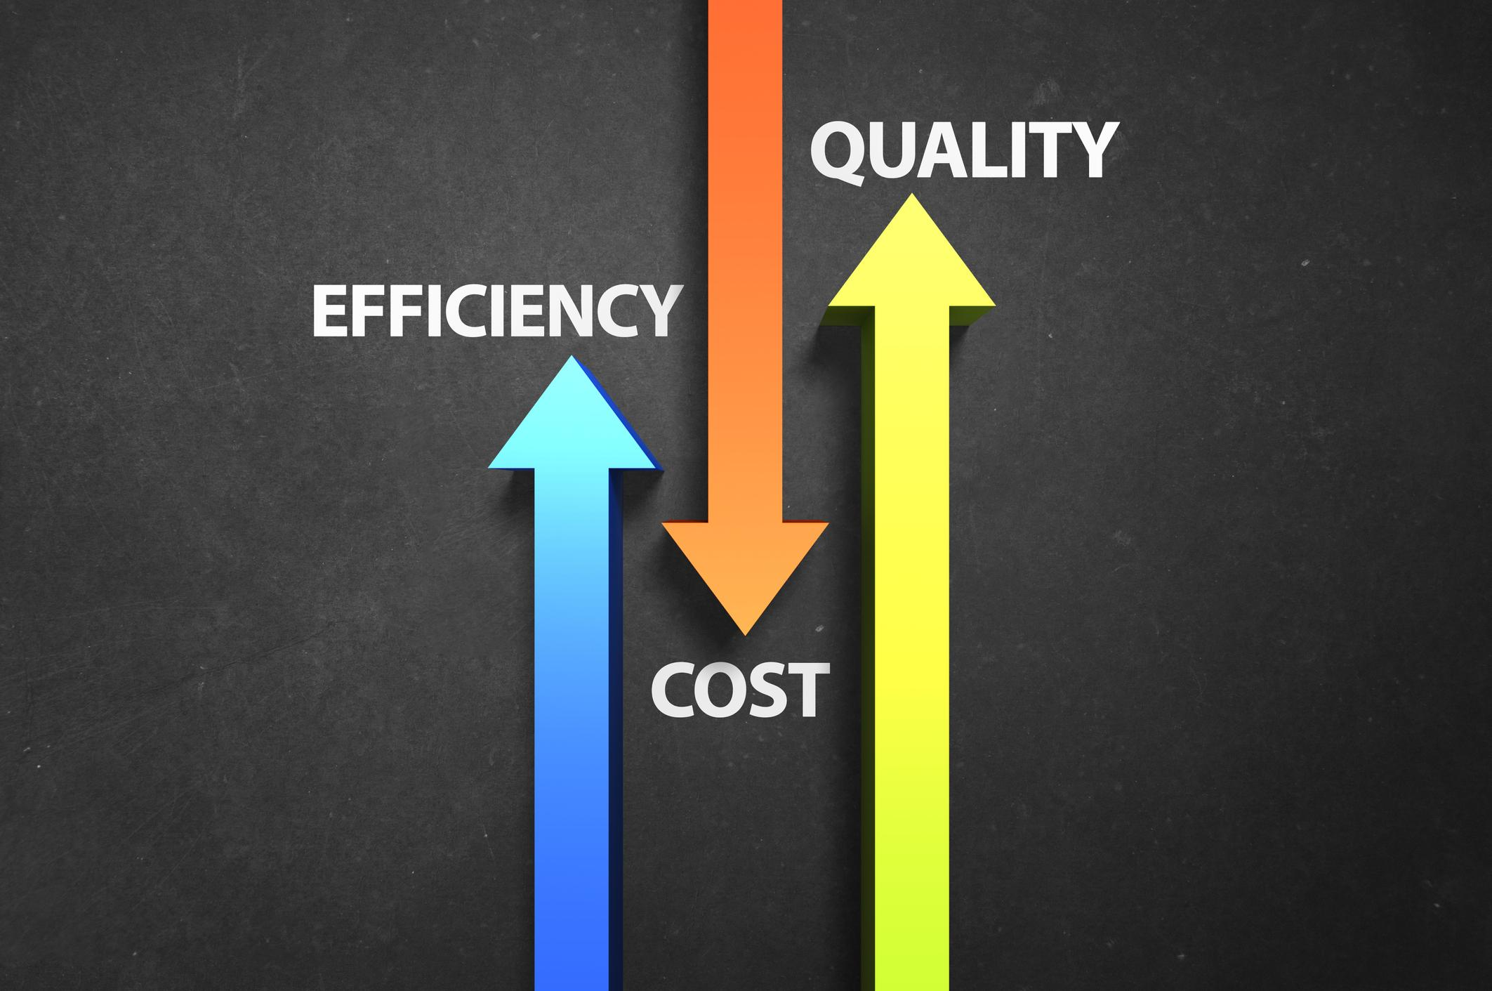
Cost Efficiency In IT Time
NetSuite integration will reduce service costs by allowing IT to be used to improve business operations.

Slide 10
Rapid Growth
Its built-in software allows for the expansion of locations and the creation of additional sales.

Slide 11
User-Focused Innovation
The process is becoming faster, and business users can use their functional knowledge to modify the apps and processes to increase their efficiency. IT can now focus on strategic projects that add value by constructing value-added solutions.

Slide 12
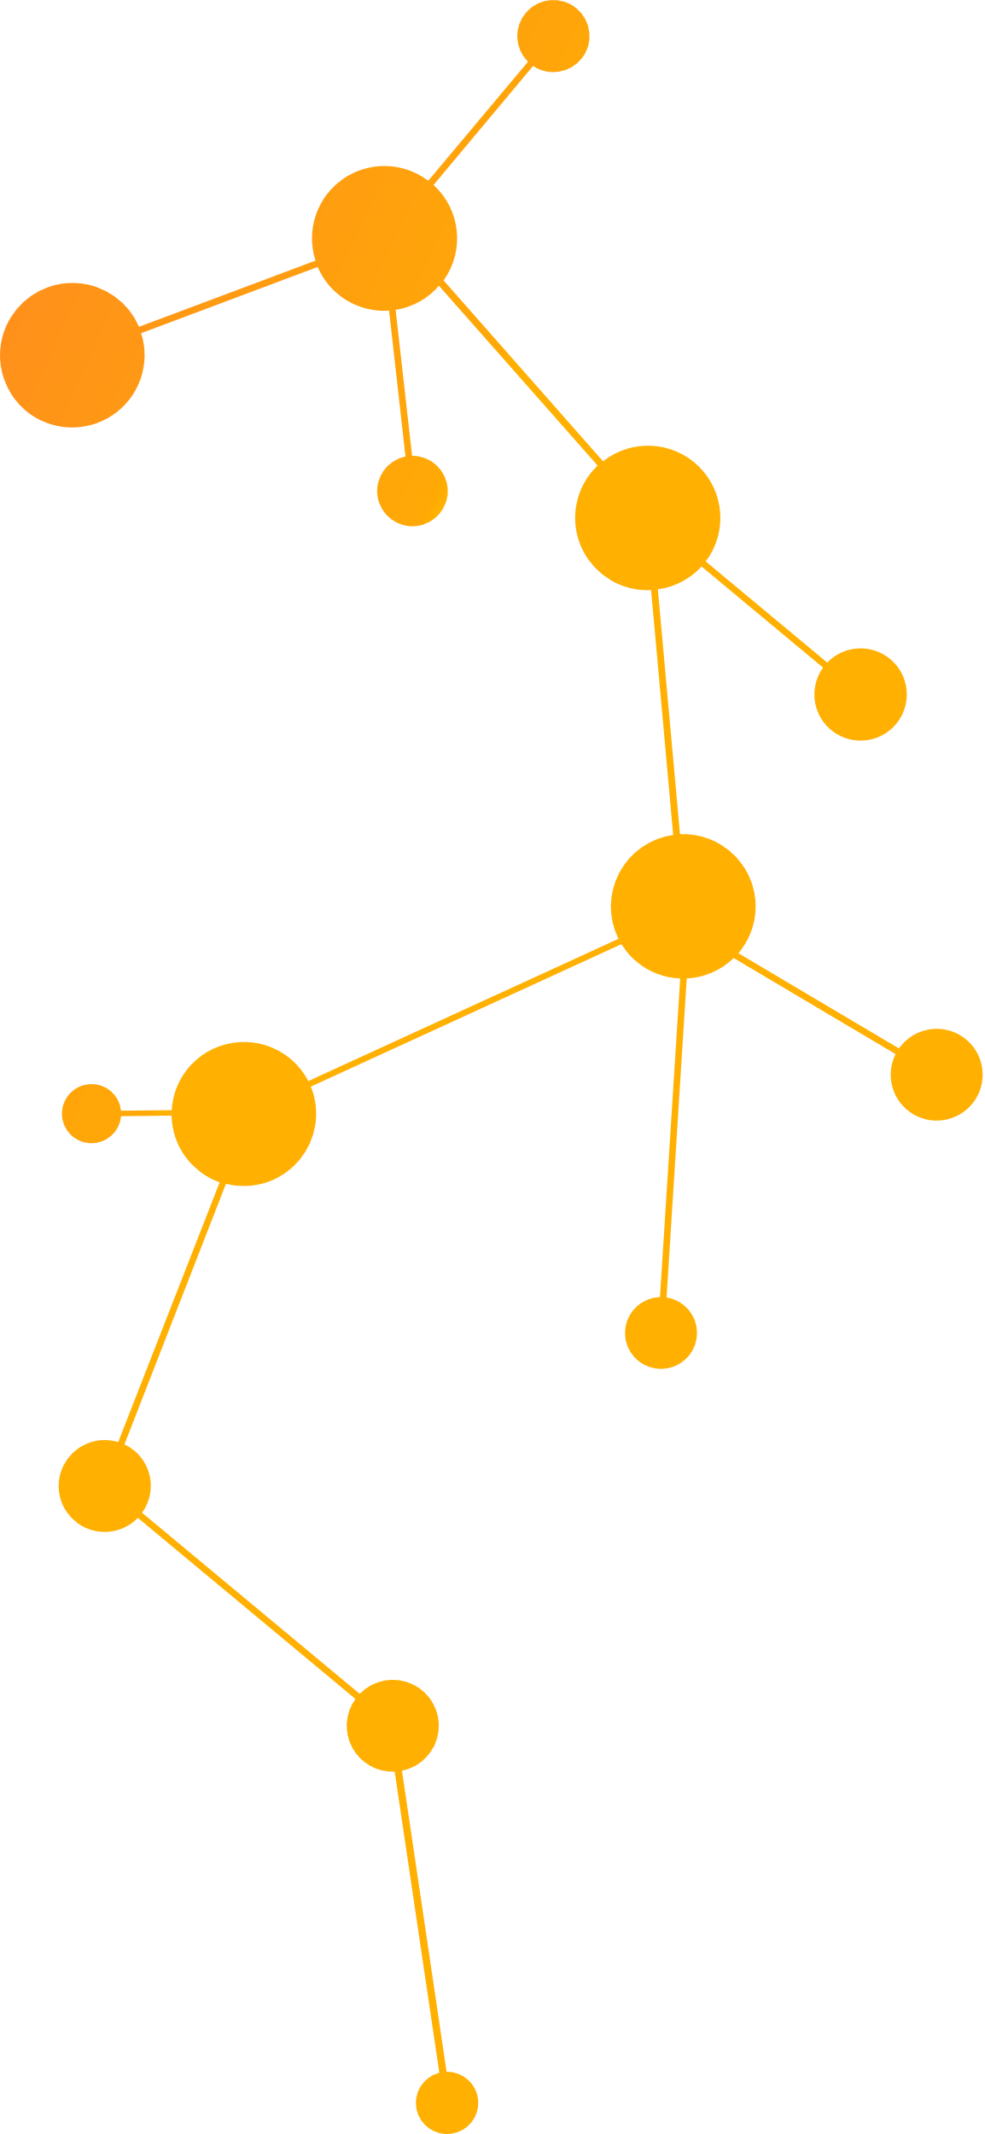
Superior Stakeholder Management
Everyone wants to work closely with their partner within a large company. It provides self-service portals to improve collaboration between B2B & B2C.

Slide 13
NetSuite Integration & Expansion
NetSuite is the most flexible SaaS solution available. It is easy to adapt to the central requirements of your company using industry-standard tools. This allows you to personalize business processes and procedures.

Slide 14
Choosing Your Partners
A solid team will make you a reliable partner. Stability is key to your ability to adapt and grow.

Slide 15
How do Folio3’s connectors Facilitate Your Growth?
Folio3 specialises in NetSuite integration solutions.
Our NetSuite specialists have created custom integrations for clients from multiple industries.
We create a flexible, scalable integration that fits your business.
It will consolidate your business processes, streamline transactions, and simplify your supply chain.
These connectors provide the same security level as NetSuite.
These integrations run within NetSuite and offer the same interface as the ERP.
We are always available for your support.

Slide 16
All about NetSuite
One unified business management suite
Encompassing ERP/Financials, CRM and ecommerce for more than 31,000 customers.

Slide 17
How can Folio3 help?
Contact us
Email Address: netsuite.sales@folio3.com
Phone Number:
+1 (408) 365-4638
Website Address: netsuite.folio3.com
We are a Certified NetSuite Alliance Partner
We are an Experienced NetSuite Partner with Deep Domain Expertise

