Slide 1

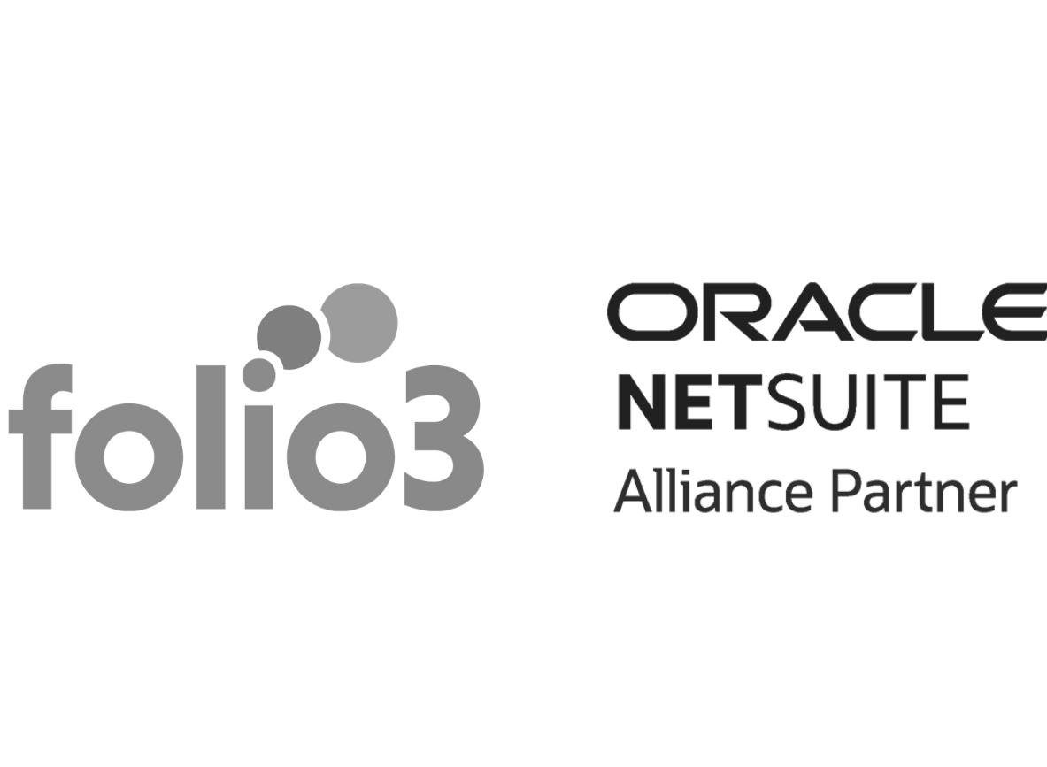
NetSuite Helps to scale fashion businesses
Notes:
Line spacing + Page numbers

Slide 2
Agenda
Industry-leading software alone is not enough
Built and delivered with industry experience
Suitesucess
Together, we can chart a course forward
Product designed with your business in mind
Unified omnichannel commerce
Real-time global inventory and management
Financials and Accounting
CRM and marketing
All about NetSuite
How can Folio3 help?
Contact us
Thank you

Slide 3
“The NetSuite solution gives us the power to successfully run the business so we can focus on growing this company we love. That ultimately motivates all of us.”
BEN IRVING, CHIEF OPERATING OFFICER, MONS ROYALE

Slide 4
INDUSTRY-LEADING SOFTWARE ALONE IS NOT ENOUGH
To deliver a truly competitive platform, you need a dedicated team of professionals who are focused on your specific business sector.

Slide 5
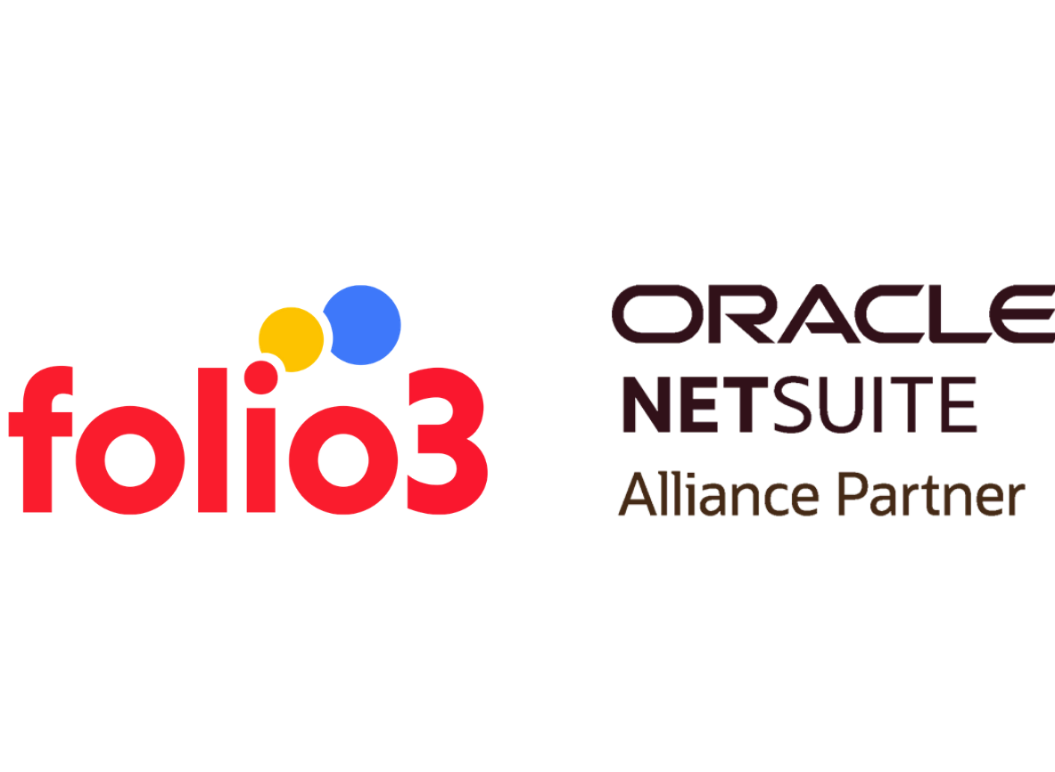
Contoso was great to work with. Patrice was my representative, and she anticipated my needs and worked diligently to fix my issue.
BUILT AND DELIVERED WITH INDUSTRY EXPERIENCE
KEY BENEFITS
You can deliver the best customer experience by eliminating outdated, costly, inefficient systems by following a prescribed Stairway method.
NetSuite’s exclusive offer allows you to maximize time-to-value. It combines NetSuite with strategic partners, strategic services and value-added products for an end-to-end solution.
Get your business running smoothly with custom features that meet the changing needs of fashion footwear, apparel and accessory brands.

Slide 6
SUITESUCCESS
SuiteSuccess offers a step-by-step approach to technology and business change. We understand that one big leap is almost impossible to transform a company.
“NetSuite allows us to dream a little bigger.”
JENNIFER HORSTMANN, CFO, HINCAPIE SPORTSWEAR

Slide 7
Together, we can chart a course forward.
Establish: Our main objective is to establish and implement a cloud-based foundation upon which future transformation can be built. | Accelerate: With targeted promotions and ROI analysis, brands can now drive cross-channel sales that are profitable.
Elevate: We are attempting to create a unified model that connects all four corners of our business, including customers, inventory and orders. | Dominate: NetSuite will deliver the technology and innovation roadmaps so that you can manage your business.
Expand: With the platform in place, brands are now free from the burden of maintaining an IT infrastructure.

Slide 8

PRODUCT DESIGNED WITH YOUR BUSINESS IN MIND
NetSuite's Fashion Edition gives your team the tools they need to monitor the business. This will enable faster and more effective decision-making while also improving customer experience and your bottom line.
PRE-CONFIGURED DASHBOARDS, KPIs AND REPORTS
Each user of AFA is provided with a dashboard. It is designed to provide only the necessary information to enable them to do their daily tasks efficiently.

Slide 9

UNIFIED OMNICHANNEL COMMERCE
KEY BENEFITS
Multi-site and multicountry support are available from one account to help you expand into new markets.
You can host both B2B or B2C web shops on the same platform.
Customize payment terms for different vendors.
Streamline your order bookings at tradeshows using mobile POS.
Use a tablet to service customers in-store and speed up the checkout process.
A B2B portal can help you drive business by allowing you to place orders quickly, get wholesale pricing, and apply for credit.
NetSuite offers omnichannel capabilities to deliver an unrivalled shopping experience, build customer loyalty, and provide 360-degree visibility of customers and inventory across the enterprise.

Slide 10

REAL-TIME GLOBAL INVENTORY AND ORDER MANAGEMENT
Key Benefits
Distribute orders and reserve inventory among retail accounts and direct customers.
True Omnichannel: Order, Return, Fulfill from Anywhere.
Accurate inventory visibility across all channels helps reduce out-of-stock.
Orders can be fulfilled faster by optimising shipments using rules that automatically fulfil orders.
You can quickly move merchandise and eliminate manual entry of replenishment and transfer orders.
Advanced Order Management allows you to create rules that determine which locations should be used to supply orders based on lead-time, availability, service level, location or any combination thereof.

Slide 11

FINANCIALS AND ACCOUNTING
NetSuite's cloud-based platform architecture provides real-time visibility of financial performance at all levels of the company, from the consolidated level to individual transactions.

Slide 12

CRM AND MARKETING
NetSuite CRM offers powerful CRM capabilities for wholesale brands as well as retailers.

Slide 13
All about NetSuite
One unified business management suite
Encompassing ERP/Financials, CRM and ecommerce for more than 27,000 customers.
NetSuite is helping over 15,000 companies transform their businesses around the globe. Your company can transform its business with NetSuite.

Slide 14
How can Folio3 help?
We are a Certified NetSuite Alliance Partner
We are an Experienced NetSuite Partner with Deep Domain Expertise

Slide 15

Contact us
Email Address:
netsuite.sales@folio3.com
Phone Number:
+1 (408) 365-4638
Website Address:
netsuite.folio3.com

Slide 16

Thank you

