Slide 1


NetSuite for Manufacturing Business Processes

Slide 2

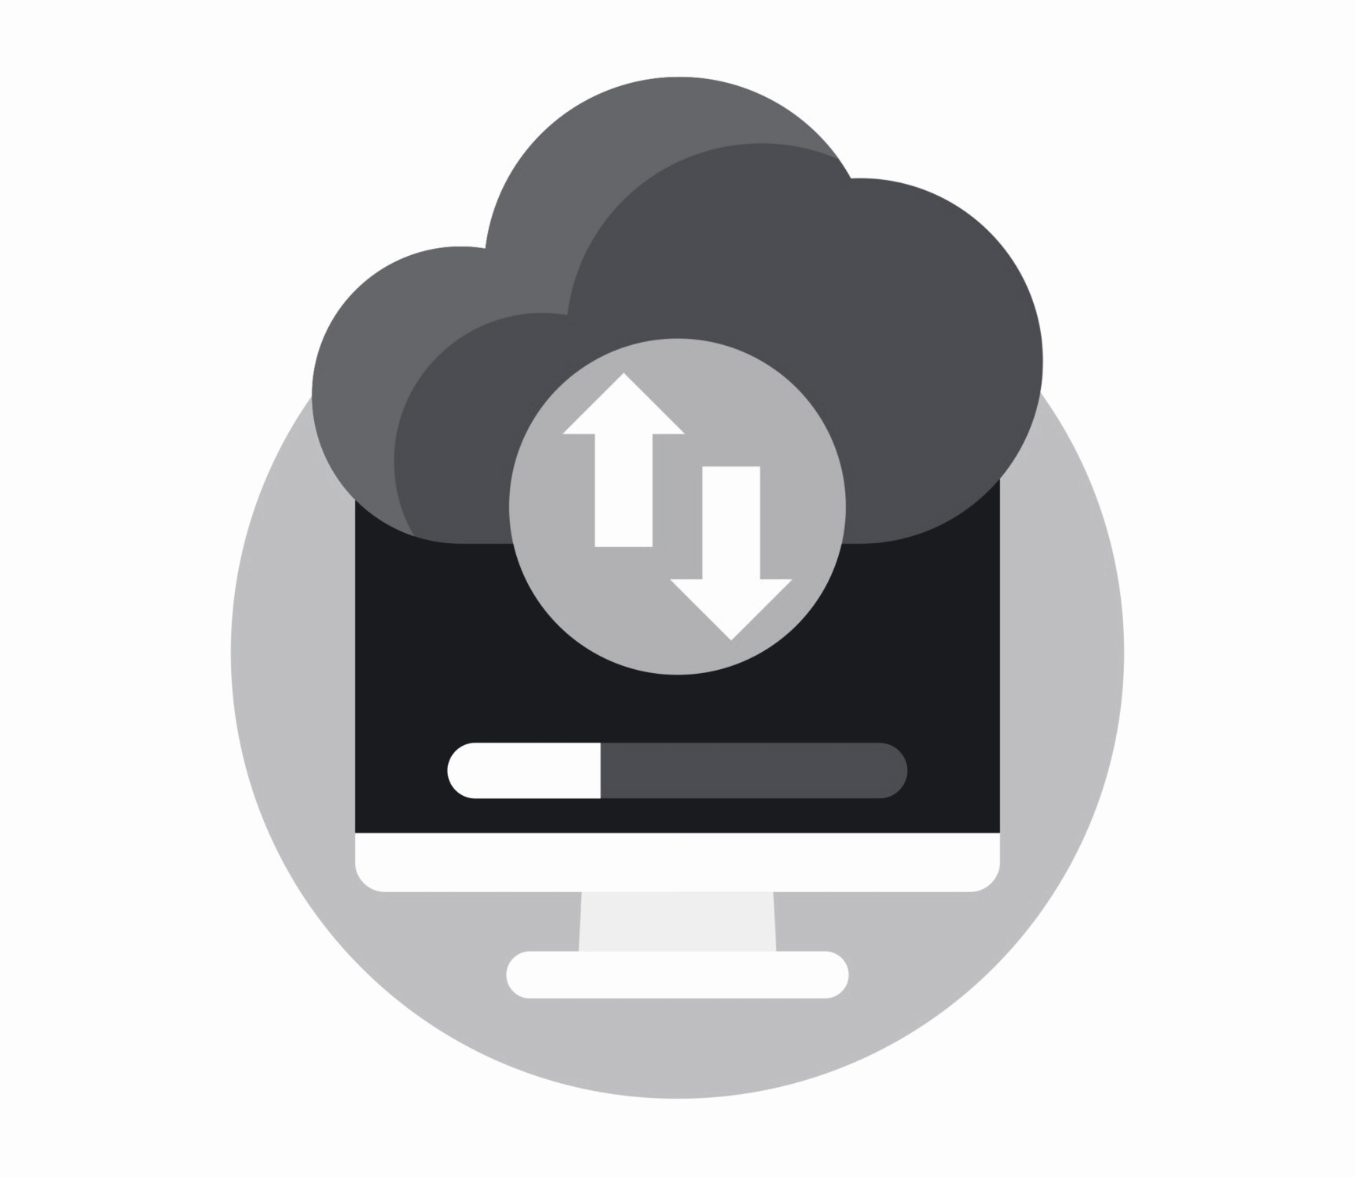

NetSuite for Business Processes
NetSuite for manufacturing business process produces workflow from the sales order to pursue procedure planning and construct products
Netsuite also assists with work orders to ensure timely deliver to the customers.
Manufacturing Assembly Work Orders
Manufacturing Advanced Bill
Manufacturing Assembly Item Records

Slide 3
NetSuite for Business Processes
Customer Management
Order Management
Core Business Functions
Revenue Management
Financial Management
Billing Management

Slide 4

Order Management
Provides real-time visibility into entire order management process with relevant information such as orders, trends and order conversion rates.

Slide 5

Financial Management
Features customizable dashboards displaying key information such as accounts receivable, orders and accounts payable. It also provides multiple reports including income statements, balance sheets, consolidated reports, variance reports and side-by- side comparisons.

Slide 6

Production Control
Streamlines production environments by automatically creating work orders from sales orders in make-to-order environments. It also features lot and serial traceability and enables both to be registered through purchasing receipts, inventory, shop floor control and sales order fulfillment functions.

Slide 7

Supply Chain Automation
Supports extended, yet fully integrated, supply chain environments by ensuring data flows seamlessly across networks. Netsuite also advances distribution resource planning by automatically suggesting, and where appropriate, generating purchase orders, work orders and transfer orders across multiple locations.

Slide 8

Need an expert for NetSuite Manufacturing Business Solutions?
Drop us your query at netsuite.sales@folio3.com.

Slide 9
Thank You
netsuite.sales@folio3.com
netsuite.folio3.com
Head Office:
1301 Shoreway Road,
Suite 160,
Belmont, CA 94002, USA
Surrey, United Kingdom
Dubai, UAE
Sofia, Bulgaria
Lahore & Karachi, Pakistan
Pleasanton, California
Chicago, Illinois
Toronto, Canada
Guadalajara, Mexico

