Slide 1
HOW TO PREPARE FOR ECOMMERCE ERP INTEGRATION WITH NETSUITE?

Slide 2
CONTENTS
WHAT IS AN INTEGRATION ?
HOW IS DONE IN NETSUITE?
INTEGRATING ECOMMERCE IN TO NETSUITE
STEPS INVOLVED IN ECOMMERCE ERP INTEGRATION
TEN BEST ERP SOFTWARE FOR ECOMMERCE IN 2022

Slide 3
WHAT IS AN ERP INTEGRATION?
Enterprise Resource Planning software automates all business functions, but a business also runs on external platforms known as Ecommerce management CMS or Marketplace.
Synchronization of data between one or more platforms using a single or multiple connectors is called an ERP Integration

Slide 4
Doing more with NetSuite by integrating various platforms into NetSuite to:
Enable synchronization
Data Updation
Automation across various CMS, Platforms, or local systems
Mitigate manual data entry errors
Folio3 offers a range of fully customizable Integration connectors
INTEGRATIONS IN
NETSUITE
Notes:
Note: Insert your picture by clicking on the Picture Place Holder Icon, then send it back!

Slide 5
ECOMMERCE INTEGRATIONS IN NETSUITE?
Integrating NetSuite with any Ecommerce system will enable you to sync sales, returns, cancellations, payments, deliveries, and other important things across one or more touch points. Be it an offline store, website, or store on marketplaces like Amazon and eBay, all data can be synced.
Integrate NetSuite with the biggest CMS in the World.
Once you’ve integrated your systems with NetSuite, updating orders, customer information, inventory details, product details, billing and accounts, and fulfillment synced automatically will be a trouble of the past.

Slide 6
NETSUITE MARKETPLACE INTEGRATION CONNECTORS

Slide 7
NETSUITE MARKETPLACE INTEGRATION CONNECTORS

Slide 8
STEPS INVOLVED IN ECOMMERCE ERP INTEGRATION

Slide 9
OUTLINE THE PROCESSES INVOLVED IN YOUR ECOMMERCE BUSINESS
LABEL PROCESSES AS A RESOURCE, LABOUR OR CAPITAL INTENSIVE
Mapping out and listing all the steps required in your business will help you identify and clearly understand which ERP integration software best suits your business.
To simplify your business, ERP integration is required; a significant step in preparing for ERP integration is identifying which business operations are time-consuming and costly and need it the most, as ERP integration will automate the process and make your business more efficient.
RECOGNISE ALL THE SIGNIFICANT SOURCES OF DATA INVOLVED IN YOUR COMPANY
CALCULATING THE RETURN ON INVESTMENT (ROI) YOU WILL RECEIVE UPON ERP INTEGRATION.
Choosing an ERP which is best for your business is heavily influenced by the type of business you run. It will create a centralised location of all crucial data in your industry. That's why identifying the critical data is essential, as it will help you select which ERP software you will use.
Calculating the return on investment (ROI) is crucial as it helps determine the profit you receive from ERP integration. This step will also help you decide how much you want to integrate your E-commerce business. A high ROI with ERP integrations means complete automation of your business operations which is more profitable.

Slide 10
10 BEST ERP SOFTWARE FOR ECOMMERCE IN 2022
When preparing for ERP integration, one crucial step is deciding which ERP software to use, depending on the type of business you run.
Find a complete list of ERP software in 2022 and the pros and cons of each to make it easier for you.

Slide 11
Pros:
Continuous updates, increasing its efficiency.
Excellent customer service and the best support system.
Users can customize it according to their needs.
Plenty of pre-built programming functions are available.
Cons:
Its expense and revenue calculation operations must be focused on more as it can be lacking a little.
Oracle offers no free in-depth training to learn how to navigate the app effectively.
When forming lists, it can be a little slow.
The keyword searches are not very precise.
ORACLE
NETSUITE
The first cloud ERP system, Oracle NetSuite, automates your business processes, making them more efficient. You can store all your data in one centralised location having information at your fingertips to help you make rapid decisions.
Notes:
Note: Insert your picture by clicking on the Picture Place Holder Icon, then send it back!

Slide 12
Pros:
SAP ERP can be accessed on any device, including mobile devices.
It offers excellent support and is available in several languages.
SAP ERP has a shortcut option on complex platforms for faster use.
It can process a massive amount of data in one go.
SAP ERP
SAP ERP is very adaptable and flexible as it allows customisation to individual business needs. SAP ERP invests in continuous new updates and offers an in-depth analysis of business operations to help users make smarter decisions.
Cons:
When using a VPN, it may face some connectivity issues.
Subscription cost is relatively high and may not be affordable for small-scale businesses.
The software Installation is a bit time-consuming.
After an update, SAP ERP may not function for a while.
Notes:
Note: Insert your picture by clicking on the Picture Place Holder Icon, then send it back!

Slide 13
SAGE X3
Sage X3 is a Cloud-based ERP software suitable for all types of business, ranging from small-scale companies to large, complex organisations. It integrates all business processes and focuses on maximising efficiency and profitability.
Notes:
Note: Insert your picture by clicking on the Picture Place Holder Icon, then send it back!

Slide 14
Pros:
You can use it on all devices, and you can customise features as per your needs.
Sage X3 is easy to use.
It also ensures data security.
Cons:
Any addition of new features requires extensive coding.
It does not offer a centralised update management feature.
Support staff takes a little while to respond.
Java Bridge errors may lead the entire system to be frozen.

Slide 15
WORKDAY
Workday is a flexible ERP software that focuses on helping companies organise and plan their operations more efficiently regardless of the scale. It reduces time-consuming or costly features to avoid distractions. Workday integrates all data in one centralised location, and its support team is always live to respond to your queries.
Notes:
Note: Insert your picture by clicking on the Picture Place Holder Icon, then send it back!

Slide 16
PROS
CONS
The app is user-friendly being easy to navigate.
You can use it while traveling as it works even with low connectivity.
The HR feature is exceptionally well-designed.
You may find the sign-in process time-consuming.
Training is not free, and the costs are high.
Updates may extend for long periods.
Notes:
Note: Insert your picture by clicking on the Picture Place Holder Icon, then send it back!

Slide 17
Microsoft Dynamics 365 is perfect for large-scale businesses, used by Coca-Cola, BMW, and Adobe. It's incredibly flexible and has separate categories for several different aspects of business operations. To boost efficacy, Microsoft Dynamics 365 is also integrated with other Microsoft applications like word and excel.
MICROSOFT DYNAMICS 365
Notes:
Note: Insert your picture by clicking on the Picture Place Holder Icon, then send it back!

Slide 18
PROS
It can be used both online and offline and is highly customisable.
To help increase productivity, it offers features like GPS tracking and site route analysis.
Offers Excellent customer service and support.
Notes:
Note: Insert your picture by clicking on the Picture Place Holder Icon, then send it back!

Slide 19
CONS
You need a license to be able to use it, which requires training and it’s time-consuming.
Microsoft Dynamics 365 is not very easy to integrate with other systems.
Its old templates make it less competitive than apps with the latest technology.
It needs a lot of initial formatting.
Notes:
Note: Insert your picture by clicking on the Picture Place Holder Icon, then send it back!

Slide 20
SYSPRO
Syspro is an ERP software which is excellent for any business type and size as its flexible and can be easily customised. It focuses on the design operations of a company. If you plan to expand your business, Syspro is the perfect option.
Notes:
Note: Insert your picture by clicking on the Picture Place Holder Icon, then send it back!

Slide 21
PROS
Syspro is very user-friendly, with no training required to navigate.
You can use data from previous orders to save time.
It has a knowledgeable key search operator
You can instantly export information to Excel.

Slide 22
CONS
No technical staff is available to help you.
To transfer data, multiple tabs need to be kept open.
You may find some bugs in the interface.

Slide 23
Pros:
Easy to use and navigate with simple steps to set up.
It offers an intelligent accounting feature to help you keep track of finances.
Cons:
It cannot cater to many users and may sometimes be slow.
ACUMATICA
Acumatica is a Cloud-based ERP software which is highly customisable and provides data security. It’s best for small to medium-sized companies and helps businesses grow using its latest technology. Acumatica offers an instant analysis feature that leads to more intelligent decision-making.

Slide 24
INFOR
Infor ERP software can be used by specific business types like fashion, construction, food etc. It is customisable and offers in-depth analytics and tracking features.

Slide 25
PROS
CON
It can be used via mobile devices and provides excellent support and customer service.
It may have forced/unexpected “downtimes” at the wrong times.
Its data collection feature is powerful.
You can instantly export information to Excel.

Slide 26
Pros:
It has a robust data collection feature.
It's effective in integrating with excel and is user-friendly.
You can schedule downtime to avoid disruption in work.
Cons:
The app installation is time-consuming.
You may find some features difficult to use as they are ‘hidden’.
KINETIC (EPICOR)
Kinetic (Epicor) is ERP software that offers strong finance and capital management features to help businesses efficiently budget resources. It helps in expanding companies by providing customisable features.
Notes:
Note: Insert your picture by clicking on the Picture Place Holder Icon, then send it back!

Slide 27
IQMS
IQMS is ERP software that helps businesses in the manufacturing industry. It offers a wide range of manufacturing tools, so integration to any apps outside it is not required.
Notes:
Note: Insert your picture by clicking on the Picture Place Holder Icon, then send it back!

Slide 28
Pros:
To create reports, Crystal Reports are used.
You can work on multiple different operations at a time.
This app ensures all deliveries are done on time
The installation fee is not very costly.
Con:
Importing data may take a lot of time.
If multiple users are operating, it may lead to decreased speed.
It does not have an effective data security system.

Slide 29
OTHER FOLIO3 INTEGRATIONS FOR NETSUITE ERP
Payment System
CRM
3PL
Gmail
Order & Warehouse
Trading Partner
Find All NetSuite Connectors and Modules here

Slide 30
ALL ABOUT NETSUITE
One unified business management suite
Encompassing ERP/Financials, CRM and ecommerce for more than 31,000 customers.
BUILT-IN FLEXIBILITY
COMMERCE-READY ERP
NATIVE BUSINESS INTELLIGENCE

Slide 31
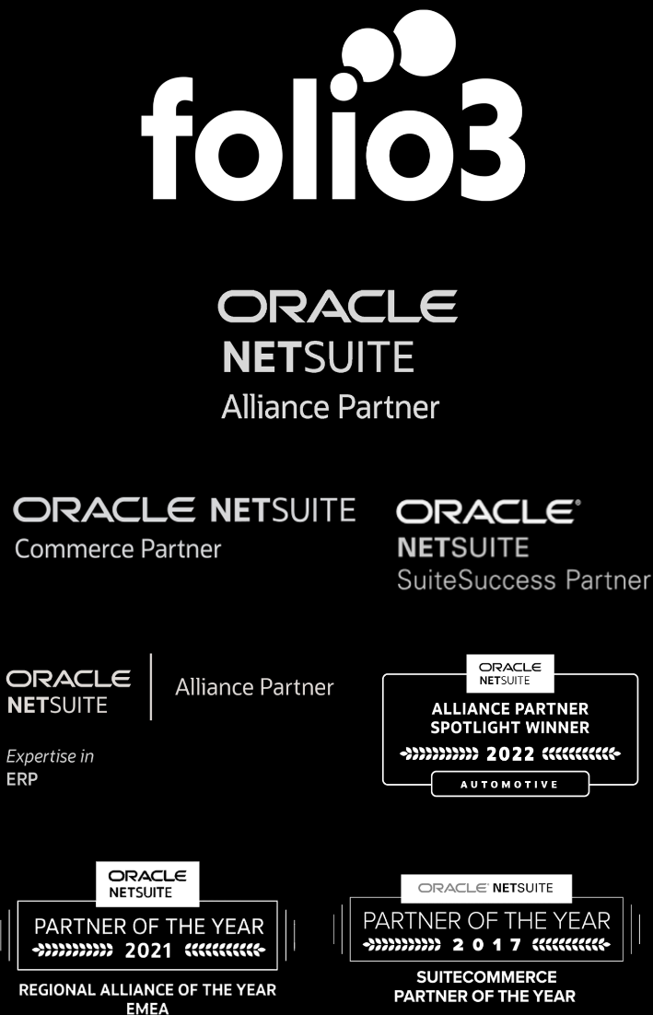
ABOUT FOLIO3
We are an Experienced NetSuite Partner with Deep Domain Expertise
Notes:
Note: Insert your picture by clicking on the Picture Place Holder Icon, then send it back!

Slide 32
Contact us
Email Address:
netsuite.sales@folio3.com
Phone Number:
+1 (408) 365-4638
Website Address:
netsuite.folio3.com

Slide 33
THANK YOU

