Slide 1

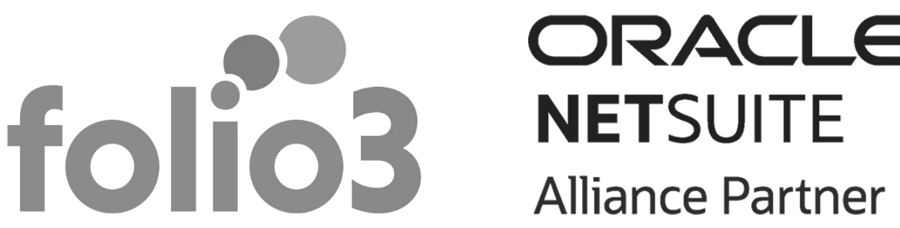
SuiteWorld 2022
What's all the Hype about?

Slide 2
Agenda
What’s it about?
SuiteWorld sessions
Meet your favorite anchors
Whom can you meet?
Who should attend?
Is it relevant to your industry?
How can it benefit your company?
Interactive Sessions to learn & connect
List of events
SuiteWorld Session Catalog
MEET OUR TEAM
About Folio3
Highlights from 2021

Slide 3

What’s it about?
Oracle NetSuite's annual conference, SuiteWorld, has been taking place for over a decade. It brings together NetSuite users, partners, and developers to network, shares ideas, and learn how to maximize NetSuite's functionality.

Slide 4


Everything Suite is in the Expo
SuiteWorld Sessions
It’s not an ordinary Expo; we’re making the show floor even more exciting by offering more chances to meet with product experts and partners and go Full Suite Ahead.

Slide 5
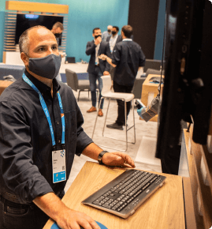
NetSuite Demogrounds
SuiteWorld Sessions
See a demonstration of NetSuite's products and speak with experts about them.

Slide 6
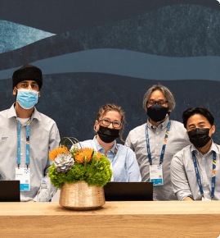

Ask the Suite Gurus
SuiteWorld Sessions
NetSuite technical experts can answer your product questions in the private 30 min session.

Slide 7
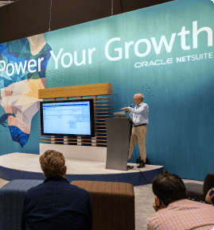
Meeting Point
SuiteWorld Sessions
Participate in open-mic discussions about some of our most popular subjects with product experts.

Slide 8
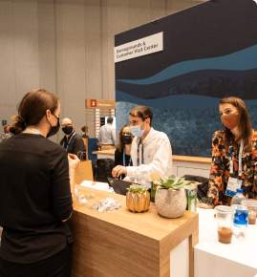
Customer Visit Center
SuiteWorld Sessions
Make sure you build on your NetSuite partnership and accomplish your corporate objectives by scheduling a private meeting at our Customer Visit Center.

Slide 9
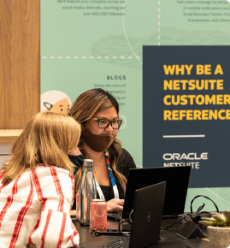
Customer Reference Lounge
SuiteWorld Sessions
NetSuite can help you showcase your company's success by leveraging its own sales and marketing platforms.

Slide 10

Social Impact Exchange
SuiteWorld Sessions
Get to learn about how the Suite Donation, Suite Pro Bono, and Suite Capacity programs are ways NetSuite supports nonprofit organizations worldwide.

Slide 11

International Lounge
SuiteWorld Sessions
NetSuite can help you address your global compliance, taxation, banking, and reporting issues whether you operate or have customers, partners, or suppliers outside the United States. Connect, learn, and network with us.

Slide 12
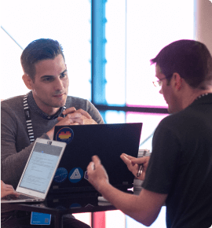
SuiteCloud Corner
SuiteWorld Sessions
SuiteCloud product experts and colleagues can help you solve your toughest Platform technology issues by sharing knowledge and best practices. Everyone is welcome!

Slide 13
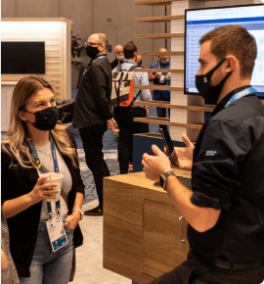
Inspection
SuiteWorld Sessions
Get health checks on your NetSuite account and personalized advice to optimize and expand your strategy.

Slide 14

UX Design Zone
SuiteWorld Sessions
Join NetSuite researchers and designers at the UX Design Zone to help build the future of the company and to express your thoughts and experiences using Design Thinking methodologies.

Slide 15

NetSuite TV
Anchor
Kendall
Fisher
When Kendall Fisher isn’t delivering all your NetSuite news, you can find her in the boxing ring, playing with her Goldendoodle Cash, or searching for the finest extra dirty martini in LA. She began her career covering all aspects of entertainment for E! News and now covers all aspects of ERP. Let’s check out some fun facts about her:
Her first car was a mustang with pink racing stripes.
Her go-to karaoke song is Bohemian Rhapsody.
Her favorite interview of all time is with Magic Johnson.

Slide 16

NetSuite TV
Anchor
Fritz
Nelson
NetSuite TV Anchor & Senior Director,
Editor-in-Chief and Head of Content at Oracle NetSuite
Fritz Nelson, who plays Kendall's TV sidekick, strives to make the perfect cup of coffee (he hates it when people say 'mouthfeel'), reads every novel on the Man Booker long list every year, and still believes he will one day be able to dunk a basketball. He currently lives in West Africa (you'll have to ask him) and heads up Oracle's content strategy, having previously overseen editorial at InformationWeek and Tom's Hardware. If you want to win his favor, bring him any of his guilty pleasures: butterscotch tapioca, halva, baklava, pavlova, or…bourbon.

Slide 17
Whom can you meet?
Various NetSuite global partners will be present at this annual gathering, where participants can access them.

Slide 18

Who should attend?
Anyone who desires to boost their company's revenue should seize this chance to meet and exchange ideas with experienced professionals who can assist the company in growing. Whether you're running a small business or a large one, you'll benefit from this opportunity.

Slide 19
Is it relevant to your industry?
NetSuite offers tools and process automation, which applies to almost any industry, so SuiteWorld attracts businesses from a wide range of domains. It's easier to see which industries it's relevant for by looking at the chart below:
Advertising and Digital Marketing Agencies | Food and Beverage Financial Services | Restaurants and Hospitality
Apparel, Footwear and Accessories | Health and Beauty | Retail
Campus Stores | IT Services | Software and Technology Companies
Consulting | Manufacturing | Transportation and Logistics
Education | Media and Publishing | Wholesale Distribution
Energy | Nonprofit
Healthcare | Professional Services

Slide 20

How can it benefit your company?
NetSuite seminars from SuiteWorld help you master NetSuite and get the most out of it. Having the chance to connect with like-minded individuals is an added benefit.

Slide 21

Interactive Sessions to learn & connect
The SuiteWorld Agenda Builder is now available! Whether you’re interested in finance, CRM, inventory, or all of the above—we have everything you need to get you and your enterprise moving full speed ahead.

Slide 22
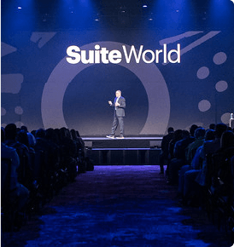
Executive Notes
Listen to NetSuite executives and industry leaders discuss what's next and how customers use the suite to be more productive, efficient, and profitable.

Slide 23
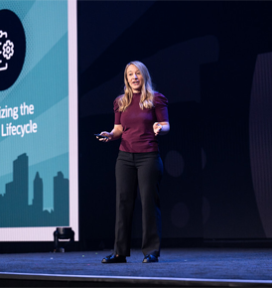
Innovative Key notes
Beyond helping attendees discover new ways to revolutionize the workplace, these sessions will inspire innovation. We will cover everything from finances to services, from products to platforms, and a session for those new to NetSuite.

Slide 24
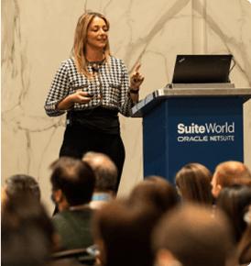
Breakout Sessions
Whether you're a product expert, an industry pro, or a NetSuite user, you can learn a lot at this event. In addition to best practices, how-to tips, case studies, and product demos, we offer a wide range of formats and levels.

Slide 25

NEW: Hands-On with NetSuite
NetSuite Education Services team members will guide you through hands-on NetSuite experience. These sessions provide demo environments and help you improve your NetSuite skills.

Slide 26

Product Roundtables
Be sure to talk with the people behind the NetSuite product development over lunch. Registration for selected topics will be available in late August.

Slide 27

Expo Theater Sessions
Come to the exhibit area to find out how NetSuite partners enhance the suite's value.

Slide 28
List of events
Partnering with NetSuite at SuiteWorld or On Air can help partners differentiate their practice, expand their businesses, and gain expertise in NetSuite. Partners will gain many advantages from attending the Partner Program at SuiteWorld or On Air.

Slide 29

SuiteWorld Las Vegas
NetSuite practice leaders, business owners, and management personnel are best suited to attend NetSuite’s Executive Partner Summit, followed by two days of classes, networking, and techniques to enhance and expand your NetSuite practice and workforce.

Slide 30

SuiteWorld On Air
The online training sessions and networking with both virtual and in-person attendees are best for partner team members responsible for implementing NetSuite for their clients or in a sales, marketing, or supporting role.

Slide 31
SuiteWorld Session Catalog (In person)

Slide 32
50 NetSuite Security Tips in 50 Minutes | Ask the Experts: NetSuite Financials, SuitePeople, and Planning and Budgeting
About golf Scores a “Hole-in-One” by Automating Its Financial Back Office | Automate Project Invoicing and Get Paid Faster with Charged-based Billing
AccControl Safety First | Automate User License Management with SuiteFlow
Accelerating Your Integration Journey. Prebuilt Solutions to Optimize Your NetSuite Investment | Automate your Business-Critical EDI with NetSuite and Boomi
A Day In the Life of a Material Planner | Automatic Location Assignment & Supply Allocation: Reducing Inventory Costs & Increasing Fill Rates
Add Intelligent Item Recommendations to NetSuite CRM and SuiteCommerce | Automating Compliance: Getting Ready for Your First Audit
Admin Excellence: Beyond the Functionality to End Users | B2B Ecommerce Strategies That Win Over Business Buyers
Admin's Guide to Customizations and the SuiteCloud Development Framework | Becoming a Rockstar NetSuite Admin
Amp Up Accounting Everywhere | Best Practices for Managing Lease Accounting
An Overview of the NetSuite Integration Landscape | Better Budgeting: Financial Visibility at the Center of your Business
AP and AR Automation Demo | Building Meaningful SaaS Metrics on NetSuite Analytics Warehouse
AP Automation on NetSuite: How tight integration helped Simple Mills accelerate its business growth | Building Your First Project with SDF and SuiteScript
AP Automation: The Connected Solution to the Financial Talent Crisis and Cash Flow Resiliency | Built for NetSuite Compliance Tools Help P-Value Group Save Time, Reduce Errors and Streamline Processes
Ask Me Anything: Compliance and Controls | Capitalizing Project Costs in NetSuite
Ask Me Anything Panel: SuiteScript, CI/CD and Platform Development | Capturing Critical Data With Custom Transactions and Custom Records
Ask Me Anything: SuiteCloud Integration Experts Panel

Slide 33
Case Studies of NetSuite Analytics Warehouse Customers | Drive Digital Transformation with Our Mobile-First Inventory Solutions, Regardless of Location
Centralize Financial and Demand Forecasting with NetSuite Planning and Budgeting | Driving End User Buy-In Before (and After!) NetSuite Implementation
Commerce / SCMA | Driving Manufacturing Efficiency Gains Through Saved Searches and Automated Workflows
Connect Billing and Subscription Management to Revenue Recognition | Dr. Search and the Multiverse of Printing
Create Working Portlets Using Saved Searches | Efficiently and Continuously Training NetSuite Users
Creating Mission-Critical Dashboards for Your Finance Team | Eliminate Data-Entry Errors With Simple SuiteFlow Workflows
CRM Strategies to Drive Sales and Deliver Exceptional Customer Experiences | Eliminate Manual Vendor Bill Entry with OCR and AP Automation without Ever Leaving NetSuite
Customer Spotlight: Scaling for Growth with Accounts Payable Automation | End Your Deployment Woes: Code Testing and Delivery With SuiteCloud Development Framework and GitHub Actions
Customization | Energizing Your Advanced PDF/HTML Printouts
Customize the Income Statement (P&L) for Your Organization | Evolving Practices, Mindset, and Culture to Realize CI/CD in Your Organization
Customizing Financial Reports | Expand NetSuite Planning and Budgeting Reporting Capabilities with Smart View for Office
Customizing NetSuite WMS: The Art of the Possible | Expensify Card 101: Automation to the Rescue
Data-Driven Storytelling and Visualizations with NetSuite Analytics and BI Tools | Extend and Customize Your OpenAir Application With Scripting
Dataset & Workbook | File Import: Pro Tips for Data Management
Developing on SuiteCommerce - Advanced Tips & Tricks | Financial Saved Searches: Go From Good to Great!

Slide 34
From Raw Materials to Finished Goods: Streamline Inbound, Staging, and Production with NetSuite's SCM Platform | How Service Tiers & SuiteCloud+ Ensure You Have the Right Capacity for Growth
Full Suite Ahead | How Supply Chain Automation Empowered ILIA Beauty for Continued Growth
Gain New Insights with SuiteAnalytics Workbook | How To Avoid 'Diversity Burnout' & Create an Environment of Unconscious Inclusivity
Give Your Sales Teams an Edge With the NetSuite Mobile App | How To Build Low-Code Customizations To Enhance Your Business Processes
Global Payouts for NetSuite Made Easy with Routable | How to Customize Dashboards Like a Pro
Going from 20 to 9 Days: How We Accelerated Our Financial Close | How To Extend Transaction Lines Using Scripts and Custom Records
Habits of Highly Effective CFOs | How to Keep up with the Changing Supply Chain
Hidden Gems of NetSuite Accounting | How to Save Time and Reduce Errors with Commission Automation
How Advanced Developers Can Up Their Game with SuiteScript | How to Use NetSuite for a Diversity Audit
How Avenue One and Tribe Capital are building a culture of financial discipline and empowering smart employee spending with Brex and NetSuite | HR & Payroll
How BirdRock Brands Uses NetSuite Connector to Connect NetSuite to Other Selling and Fulfillment Channels | Impact Investing and Leveraging NetSuite for Growth
How CFOs Survive Toxic Workplaces | Improve Customer Service with Case and Issue Management
How Crocs Drives Operational Excellence Across Multiple Business Units With Intelligent Automation | Improving Change Management in NetSuite with the SuiteCloud Development Framework
How Mailchimp shifted their business from high risk to complete visibility using NetSuite and Gatekeeper via a fully integrated SuiteApp | Increase Automation and Productivity in NetSuite for On Premise and Remote Teams
How People + Insights = Project Profitability | Increasing B2B Sales and Reducing Costs with NetSuite CPQ

Slide 35
Increasing Efficiency and Accuracy With a Unified Payroll | Let's talk data
Innovation Ahead | Leverage Software Dev Tools and Practices to Better Manage your NetSuite Instances
Insights from a Veteran CFO: From Startup to Scale Up | Make NetSuite the Center of Your Enterprise Through Integration & Customization
Integration | Managing Change: Track and Control Engineering Changes with NetSuite Advanced BOM's and ECO’s
Interact with Your Prospects & Customers with Ease: Talk, Text, Chat and Email Direct from NetSuite | Managing Intercompany and Global Financials with OneWorld
Introducing NetSuite CPQ: Empower Sales to Configure, Price and Quote Complex Products and Services | Managing International Reporting Requirements
Introducing the New Rebate and Trade Promotions SuiteApp | Managing Roles and Permissions: Take Custom Roles to the Next Level
Introduction to NetSuite MRP | Manufacturing Industry Top Trends and How NetSuite Addresses Them
Intuitive Reporting and Dashboards for Project Managers | Mastering the Month-End Close for Better Reporting and Easier Audits
It's 3 a.m. Do You Know What Your Admin Is Doing? | Maxima is Racing Toward ERP Success & Warehouse Automation with ShipHawk
It Takes Two to Tango: Preventing Fraud by Segregating Duties | Maximize Operational Efficiency with NetSuite CPQ
Killer KPIs to Supercharge Your Dashboards | Maximizing the Value of the SuiteCloud Platform with NetSuite Records
Labor Capture, Costing and Time & Attendance in NetSuite | Mexico & Colombia Localization
Leading Amazon Footwear Retailer ORVA Shares Its NetSuite Journey [OPS1678SES] | NetSuite Administrator Tips & Tricks
Leading Practices in Project Accounting | NetSuite AI in Commerce & CRM
Lease Accounting and 5 Other Native Apps for IPO-ready Financials | NetSuite Analytics Warehouse: Bring Data Clarity to Business Challenges [FIN1163SES]

Slide 36
NetSuite Analytics Warehouse: Power of BI | On the Horizon: Customer Experience Roadmap
NetSuite CPQ | On the Horizon: What's New With NetSuite Analytics Warehouse
NetSuite CPQ in Action (Altimate Medical Case) | OpenAir: Customizing Standard Reports and Other Reporting Options
NetSuite CRM | Optimize Manufacturing in NetSuite: WIP & Routings and Manufacturing Mobile [OPS1441SES]
NetSuite Factory of the Future | Optimize Security, Performance & Integrations the Right Way
NetSuite Improvement Initiative: Genesys Story | Optimize Workforce Scheduling and Overtime Costs
NetSuite ML/AI at Work – Continuous Intelligence in NetSuite Products and Services | Overcome Supply Chain Obstacles with Supply Allocations, Channels & Reservations
NetSuite Revenue Management: Setup & Use Cases | Payment Industry Trends: What’s here today. What’s coming tomorrow. And why it matters to you.
NetSuite Ship Central: Tips, Tricks and Updates | Performance Strategies in SuiteScript
NetSuite Tips and Tricks For Project Managers | Planning & Budgeting: The Key to Maximizing Success
NetSuite Tips and Tricks to Increase Productivity | Power of REST: NetSuite Integration Platform Overview
NetSuite Tips and Tricks to Increase Productivity | Prepare Better Using NetSuite Planning and Budgeting
New and Improved SuiteCommerce InStore | Preparing for Your First, Next or Best Audit
New(ish) to NetSuite? Here Are Your Keys to Success | ProBono Genius Bar at SuiteWorld
NextService Field Service Management Software Native to NetSuite. Imbema Customer Story. | Procurement Product Feedback
OneWorld | Procurement, Purchasing, AP: A Process That Must Tie into NetSuite

Slide 37
Project Planning in a Single Screen With OpenAir's Project Center | Simplifying Rev Rec Complexity with NetSuite Revenue Management
Protect Your Data: Access Control and Change Management in NetSuite | Smart Count: Make Paper Inventory Counts a Thing of the Past
Real World Access Control Monitoring | Social Impact Hackathon 4Good
Regain Control Over Stock Levels and Profit Margins With NetSuite Inventory Management | Software Industry Top Trends and How NetSuite Addresses Them
Removing Barriers to Growth: Optimizing Your Tax Strategy to Support Today’s Unified Omnichannel Business | Solving Retail Challenges: Native NetSuite Automation for an Omnichannel Supply Chain
Resilient Integrations Without Third-Party Middleware | Speed Up Cash Flow in Uncertain Times: How connecting your AR team to your customers is key to unlocking cash flow
Retail Industry Top Trends and How NetSuite Addresses Them | Stairway To Scanning: NetSuite Warehouse Management
Revenue Recognition | Standardizing Analytics - Accessing SuiteAnalytics Workbook Datasets through APIs and Scripts
Revolutionizing Business Insight with Dataset Linking | Staying compliant with Avalara’s broad range of solutions
‘Running’ an Efficient Warehouse with NetSuite and RF-SMART | Steps to Improve Financial Decision-Making with SuiteAnalytics Workbooks
Saved Searches: How Do I Find My Field? | Strategic Procurement & Global Supply Chains
Saving Time With Advanced PDF/HTML Templates | SuiteAnalytics Workbook: Datasets and Visualizations
Scaling Your System to Excellence by Creating Efficiencies and Leveraging ACS | SuiteApp Distribution
Securing the Cloud | SuiteCloud Platform Update and Highlights
Sell Faster and Smarter with Sales Force Automation | SuiteCloud SDK
Services Industry Top Trends and How NetSuite Addresses Them | SuiteGuru

Slide 38
SuiteProjects Product Feedback | The Ultimate Dashboard: Value-Driven Design
SuiteWorld Day 1 Announcement Breakdown | The Unexpected Career Change: Adding ‘NetSuite Administrator’ to Your Finance Position
SuiteWorld Day 2 Announcement Breakdown | Tiger Tail USA Muscles through Supply Chain Constraints and Reduces Fulfillment Time by up to 75% with Pacejet and NetSuite
Supply Chain Disruptions? Reduce Complexity while Maintaining Fill Rates & Service Levels | Tips and Tools to Optimize Cash Management with NetSuite
Tackling the NetSuite Skills Gap in 2022 and Beyond | Tips and Tricks to Avoid Common Anti-Patterns in SuiteScript
Take Control of Your Cash Flow | Tips & Tricks: NetSuite Saved Search
Take Control of Your NetSuite Account and Optimize Cost of Operations | Tips & Tricks: Optimize OpenAir Resource Management
Taking Your SuiteCloud Development to the Next Level with Common Building Blocks | Too Suite To Be True: Improving Your S&OP Process in NetSuite
Test-Driven Development in the SuiteCloud Platform | Transformation Doesn’t Have to Wait
The Admin's Guide to SuiteAnalytics: Turn Insight Into Action | Turn ERP-led Digital Transformation into Digital Domination
The Alliance of HR & Finance: From Cost Center to Partner | Understand Data Relationships in NetSuite
The Journey From SuiteBundler to SDF Account Customization Projects | Unexpected Error: Troubleshoot Like a Pro
The Most Complete Approach to Access Management and SoD | Unleashing the Power of Oracle Cloud Infrastructure (OCI)
The Real Costs of Inventory Revealed | Unlocking Power: A Deep Dive into NetSuite's Customization
The Road After SuiteWorld: Creating Your Action Plan | Unlocking the Power of PSA by Leveraging OpenAir and NetSuite Financials
The Road to Lease Accounting Compliance within NetSuite | Unlocking the Power of Rebates

Slide 39
Unlock Your Inventory Cache With Valogix' Advanced Demand and Supply Planning
Using CRM With SuiteProjects: Leading Practices for a Dynamic Duo
Using Six Sigma to Unlock Greater Profitability with SuiteFlow
Vets In Tech: "What Veterans Bring to the Tech Industry“
Want to Get Paid Fast? Make It Easy
Welcome Reception
What's New in Latin America?
What's New With NetSuite AP Automation
What’s New With NetSuite AP Automation
When the Planets Align: Building, Extending, and Integrating Apps on OCI
Why Transforming Your Spend will Empower Your Team
With Big Money Comes Big Responsibility: VC Funding, Investments, Audits, Security & More
WMS Product Feedback
Workforce Time and Attendance
Your Support Journey with NetSuite: How to get help effectively

Slide 40
SuiteWorld Session Catalog (On Air)

Slide 41
10 Simple NetSuite Extensions That Shouldn’t Be Such A Secret | A One-Stop Shop for Winning Automation Solutions in POS, Delivery Routing, and Rental Management
8Quanta's NetSuite Solutions - Signature Capture, Estimated Landed Costs Plus, eMail Groups & Credit Card Processing | AP and AR Automation Demo
Accounting with NetSuite: An Overview | Are You Ready for the Buyer-Driven Sales Revolution?
Accrualify | Ask Me Anything: Unlock the Value of NetSuite for Nonprofits
Achieving Quality Excellence: Introduction to NetSuite QMS | Automate Tax Reporting with Built for NetSuite SuiteTax Tools
A Day in the Life of an SPS Commerce Customer | Balancing Growth and Efficiency: How NetSuite Supports the 7 Stages of the Business Life Cycle
Admin Basics 101: Exploring Customization Capabilities for Non-Developers | Best Practices for Managing Fixed Assets
Admin’s Guide to SuiteTax Benefits and Migration | Boosting Project Profitability With SuiteProjects
Advanced Tips & Tricks to Take Your NetSuite Game to the Next Level | Brace for Efficient Accounts Payable with NetSuite and AvidXchange
A Global Solution for Complex Communications Taxes | Building Better Datasets & Visualizations with SuiteAnalytics Workbook
A Grassroots Nonprofit Scales Supply Chain and Inventory Management Processes | Building Meaningful SaaS Metrics on NetSuite Analytics Warehouse
All About NetSuite ERP | Cloud Supplier Risk Management
Allocate Labor & Payroll Expenses with the New Labor Expense Allocation SuiteApp | Coffee, Collections, and Cash Flow
Amplify Your Impact by Connecting Financials and Program Data | Combatting Labor Shortage and Supply Chain Disruption

Slide 42
Compliance and Privacy | Fast, Automated and Secure Payment Processing with MerchanteE for SuitePayments – Demo
Connect Billing and Subscription Management to Revenue Recognition | Financials for Scaleups
Continuous Accounting: An End to Close Chaos | Fixing Holes in Your SOX, SOC, ISO, & More
Continuous Training for NetSuite Users | Folio3’s Real Estate Module
Demand Planning for the Modern Supply Chain | Free Lease Accounting with NetLeaseGo
Develop a winning accounts payable strategy using an API-first approach | Full Suite Ahead
Dramatically Boost Your Team’s Collaboration and Productivity with this Native NetSuite Chat App | Future of Finance and Operations
Drive Digital Business Transformation with High-Fidelity Inventory Data & Visibility | Gain Visibility and Control Over your Procurement Operations
Efficient and Effective Custom Record Cleanup | Get Paid Faster With Automated Payments
Eliminate Six Sigma Waste and Drive Profitability with SuiteFlow | Getting Started with Planning and Budgeting
Everything in Sync: Getting the Most out of AP Automation with NetSuite | Global Trends in Global Tax Regulations and Compliance
Expand NetSuite Planning and Budgeting Reporting Capabilities with Smart View for Office | Going Deep with N/Query
Expensify Card 101: Automation to the Rescue | Growth ‘At Any Cost’ Is Over
Extreme Security Makeover | How ACS Helps Your Team Achieve ERP Excellence

Slide 43
How and why a high growth fintech startup, Ramp, migrated to NetSuite | How to Save Time and Reduce Errors with Commission Automation
How Avenue One is building a culture of financial discipline and empowering smart employee spend with Brex and NetSuite | How to Use NetSuite for a Diversity Audit
How Mailchimp shifted their business from high risk to complete visibility using NetSuite and Gatekeeper via a fully integrated SuiteApp | How We Built a Global Granting Platform on NetSuite
How NetSuite Analytics Warehouse Solves Complex Questions to Make a Significant Business Impact | I’m Live on NetSuite. What’s Next?
How NetSuite Automates the Financial Close [ | Impact Investing and Leveraging NetSuite for Growth
How Pre-Revenue and Small to Midsized Life Sciences Firms Can Leverage Cloud ERP to Accelerate Growth | Increasing Efficiency and Accuracy with a Unified Payroll
How To Avoid 'Diversity Burnout' & Create an Environment of Unconscious Inclusivity | InfinetCloud MyPay: Learn to extend NetSuite by making employee time, expenses and leave, simple with less clicks, less paper and less hassle
How to Get Your Ecommerce Web Store to Show Up In Search Results | Innovation Ahead
How to Implement a Continuous Optimization Program in as Little as Two Weeks | Integrated Business Planning; Building a Resilient Supply Chain using Demand Driven Methods in NetSuite
How to Keep up with the Changing Supply Chain | Integrate NetSuite & Square for Retail POS
How to Leverage NetSuite MRP to Optimize Contract Manufacturers | Introducing NetSuite CPQ: Empower Sales to Configure, Price and Quote Complex Products and Services
How to Manage Access for Various User Types | Introduction to FieldAware: Extending the Power of NetSuite to the Field
How to Save Time and Money Using Integrated Payments and Single-Screen Reconciliation in NetSuite | It Takes Two to Tango: Preventing Fraud by Segregating Duties //REPEAT

Slide 44
Leverage Software Dev Tools and Practices to Better Manage your NetSuite Instances | NetDynamic and To Hire ATS
Leveraging NetSuite & ONSIGHT Field Service & Delivery To Run Your Field Service Team | NetSuite & Adra: Make the Most of Your ERP Investment
Making Admin Life Easier With NetSuite Support & Assistance | NetSuite Cash 360 – Bringing your cash into full view
Making NetSuite Payroll Data More Strategic For Global Users | NetSuite Commerce
Making your Single Source of Truth Accurate and Current for All Non-payroll Spend. | NetSuite CPQ
Managing Intercompany and Global Financials with OneWorld | NetSuite CRM
Managing International Reporting Requirements | NetSuite CRM Tips & Tricks for Marketing
Manufacturing Scheduling Made Simple | NetSuite CRM Tips & Tricks for Sales
Mastering Supply Chain Complexity: Validate Customer Ship Dates Via Supply Allocation | NetSuite Factory of the Future
MessageMedia Demonstration | NetSuite for Construction Companies - Appficiency's Horrible Idea...That Really Works
Mobile Apps At Work in Supply Chain Management | NetSuite in Latin America: What to Expect
MRP Basics | NetSuite & Salesforce: Better Together
Need to Do More with Less? AI and machine learning auto-matches payment and remittance data to open invoices with over 90% accuracy | NetSuite Tips and Tricks to Increase Productivity
NetClose Free Accounting and Close Task Management, Plus Reconciliations and More in a Native App

Slide 45
New(ish) to NetSuite? Here Are Your Keys to Success | Pricing to Protect Profit in a Volatile Supply Chain
Next generation SuiteFlow | Printing and Emailing experience
NextService Field Management Software for NetSuite | Privacy in the Cloud
On the Horizon: OpenAir Roadmap | Private Equity Transformation
Overview of New UI and Functionality for the Everyday User | Realizing the Value of Automated Lot Traceability and Numbering
Using Roles and Filter Sets to Control User Access | Rebate Management & Trade Promotions
Optimize your NetSuite investments – Integrate Your Data and Automate Your Workflows | Rebate Management with Brian Baumgartner and Enable
Optimize Your Workflows With SuiteFlow Tips and Tricks | Reduce the Risk of Error and Fraud by Automating Monitoring Controls
Order Reservations: How to Separate Booked Supply From General Inventory | Reduce the stress, burden, and complexities of sales tax
Period Close: A/P | Reinventing the Financial Back Office
Period Close: A/R | Revolutionizing Business Insight with Dataset Linking
Period Close: G/L | Save Time and Increase Productivity with Excel and Email Integration Applications for your NetSuite Environment
Presenting the case for selecting an integration partner with Native to NetSuite applications | Seamlessly Interact with your Prospects & Customers: Talk, Text, Chat and Email Direct from NetSuite
Preventing Internal Data Breaches: Security and Controls to Protect your Data | Shipping in a Constrained World: Okuma Fishing Tackles Warehouse Attrition and Doubles Order Processing Speed with NetSuite and Pacejet

Slide 46
Shipping in Uncertain Times: How to Prepare for the Unpredictable | Take Control of Your NetSuite Account and Optimize Your Cost of Operations
Simplifying Time and Expenses With OpenAir Mobile | The 5 Best Practices to Automate AND Optimize All Your Business Processes
Smarter and easier ways to reconcile your cash, credit cards and vendor payments using Nolan Business Solutions’ certified Native SuiteApps! | The 7 Steps to a Successful ERP Implementation
SPS Commerce – Full Service EDI for NetSuite | The Cash Flow Imperative: How to get paid faster in the coming economic downturn
Step up your tax game with ONESOURCE Indirect Tax | The Dynamic General Ledger in Action
Streamlining & Optimizing Financial Reporting with Jeff Catt, DFIN’s Senior Vice President of Global Sales, ActiveDisclosure | The Future of Finance Automation - Are You Prepared?
SuiteAnalytics: Reporting 30,000-Foot Overview | The Future of Finance is Human-Centered
SuiteAnalytics: Searches 30,000-Foot Overview | The Modern CFO: Think ERP, Think Ecosystem - How NetSuite Users Can Streamline Their Order to Cash, Treasury & R2R Processes
SuiteAnalytics Workbook for Developers | The Most Complete Approach to Access Management and SoD
SuiteAnalytics: Workbooks 30,000-Foot Overview | The Power of Financial Visibility with Reporting and Dashboards
SuiteGuru - Virtual | The Rise of Operational Accounting
SuiteQL: Level Up Your Queries Using Advanced SQL Techniques | The Road to Lease Accounting Compliance within NetSuite
Supercharge Your NetSuite ERP & Address Disruptions Head On | Tips for Completing an Inventory Count (Without Pulling Out All Your Hair)
Tackling the NetSuite Skills Gap in 2022 and Beyond

Slide 47
Tips & Tricks for Success: NetSuite for Social Impact | Utilizing the Technology Lever in Your Record to Report Landscape
TradeCentric, formerly PunchOut2Go Enhances NetSuite Procurement to Capture More Spend | Warehouse Readiness for Oracle NetSuite WMS
Transformation Doesn’t Have to Wait | What is flexible commerce? Projecting the future of commerce and adapting solutions to support what’s coming next.
Troubleshoot 'Unexpected Error' Like a Pro | What's New for Nonprofits in NetSuite
Turn ERP-led Digital Transformation into Digital Domination | What's New in Latin America?
Unleashing the Power of Oracle Cloud Infrastructure | What’s New with NetSuite AP Automation
Unlock the Hidden Power of NetSuite through AP Automation + OCR | Why Transforming Your Spend will Empower Your Team
Unlock Your Inventory Cache With Valogix' Advanced Demand and Supply Planning | With Big Money Comes Big Responsibility: VC Funding, Investments, Audits, Security & More
Using Dynamic Dashboards to Stay in Touch With Your Organization | WMS: It’s Easier Than You Think
Using NetSuite Connector to Connect NetSuite to Other Systems

Slide 48



ROBERT TERRY
Sales Director
ADNAN LAWAI
CEO
We’re looking forward to connecting with new businesses and some old partners who’ve worked with us for years.
CHARLES THEVENET
MEET OUR TEAM
Customer Success Director

Slide 49




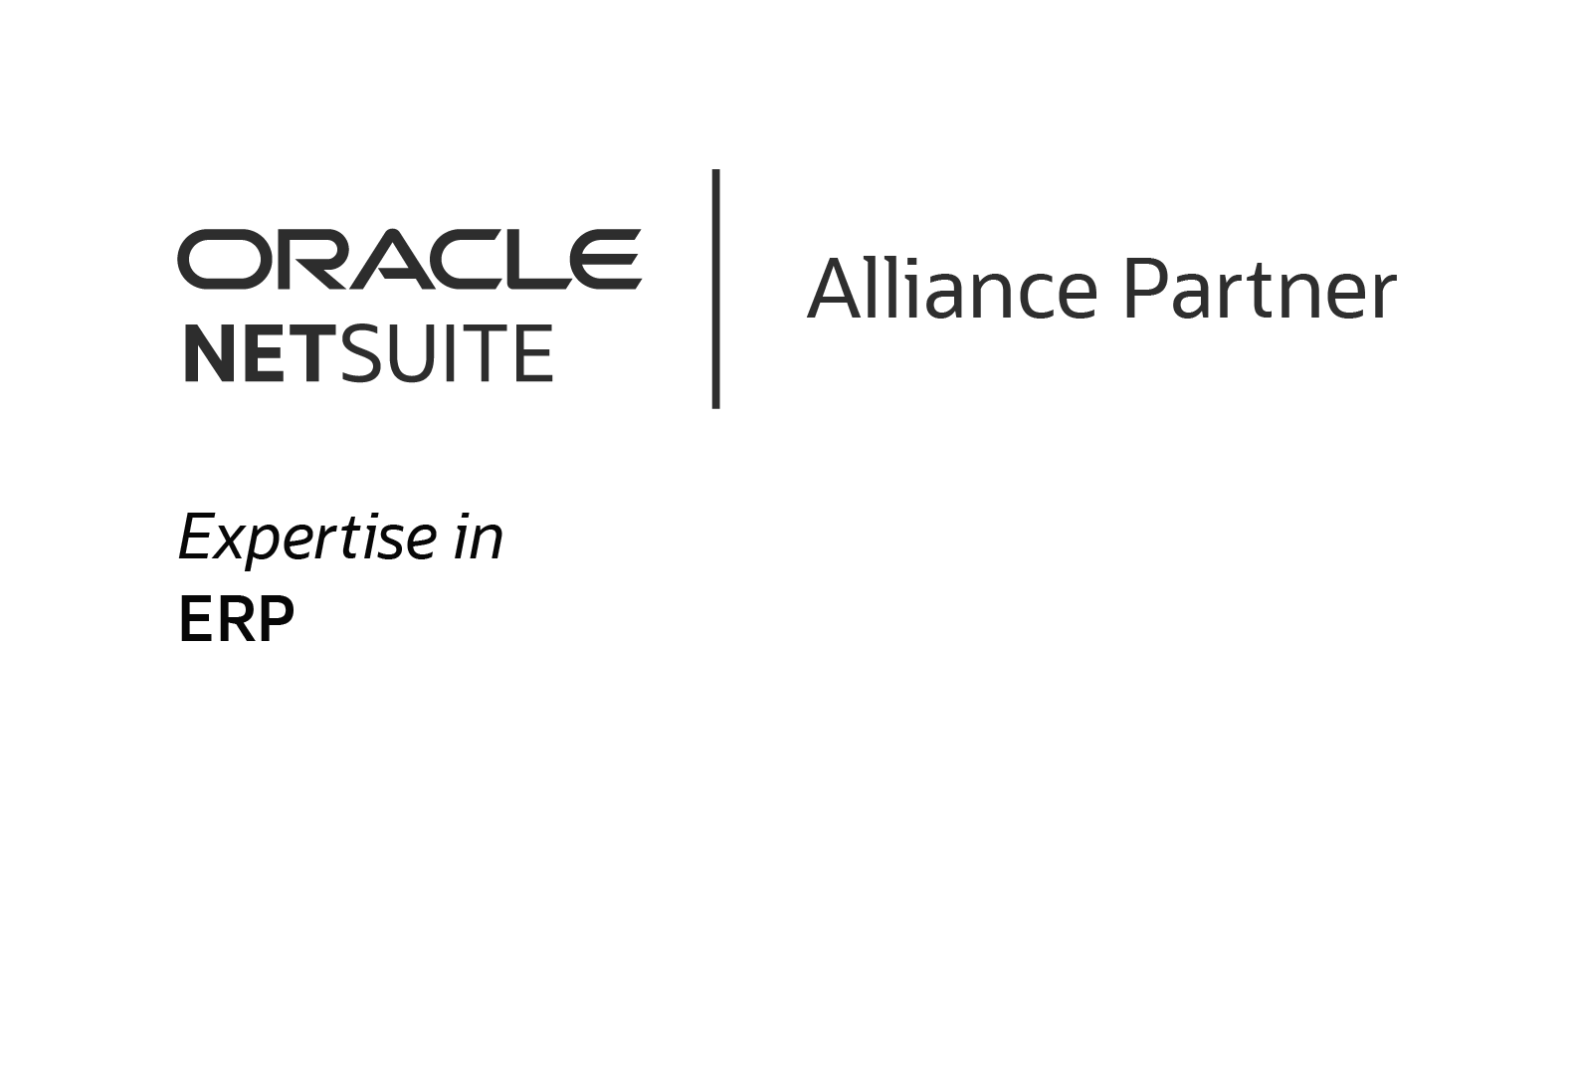



ABOUT US
Folio3 is a multiple award-winning agency who has recently won 3 back-to-back awards from NetSuite, will be attending the event with its team.
The company has also bagged other awards over the years

Slide 50

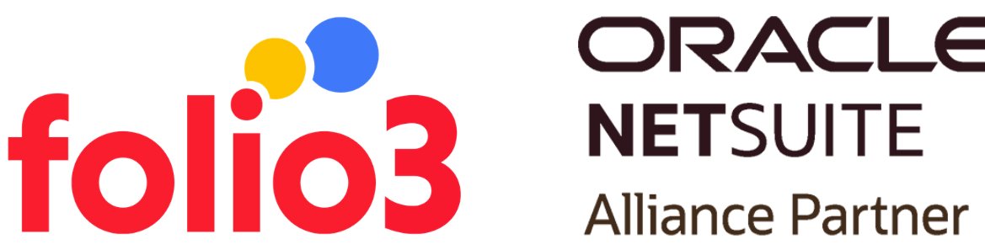
Highlights from 2021

Slide 51



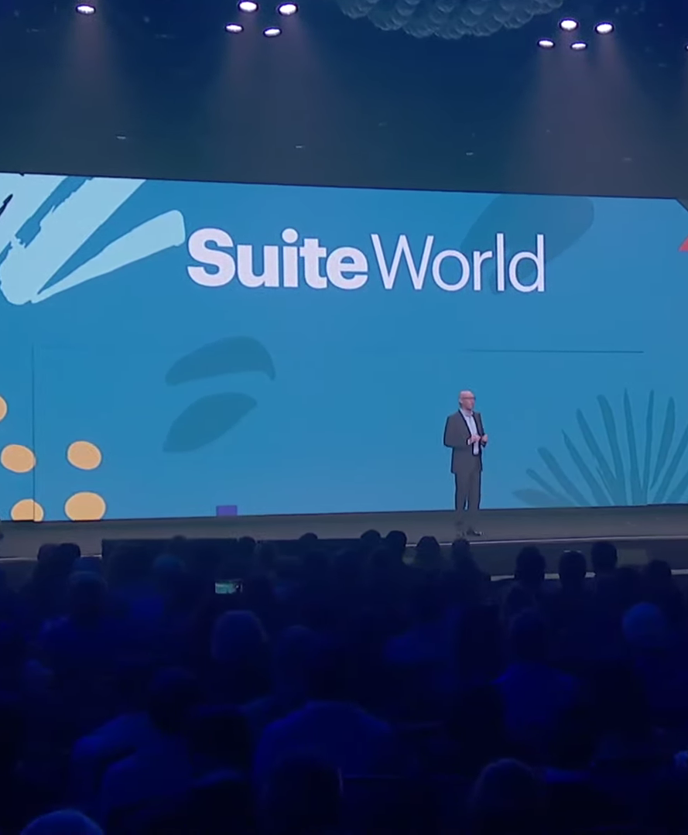

Opening Keynote Speaker Session
by Evan Goldberg (Founder and EVP of Oracle NetSuite), where he talked about their journey and the struggles of most businesses. He continued with examples of some of the customers NetSuite has been able to help from various business sectors.

Slide 52
“Power Your Growth” was the theme for SuiteWorld 2021, which focused on the current popularity of superheroes.
Hackathon4Good
Power Your Growth
SuiteWorld 2021 started off with a keynote session following an all-day Hackathon4Good challenge, along with a Partner Summit.

Slide 53
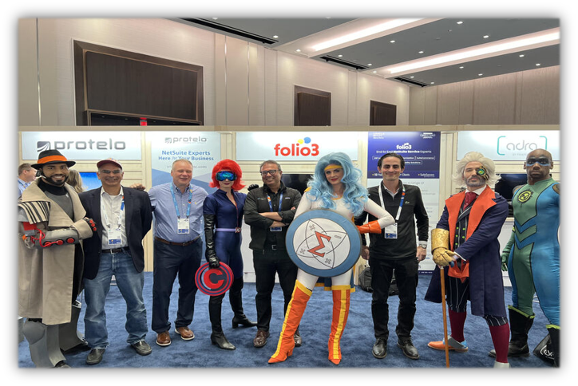
SuiteWorld Possibilities
You can even meet Superheroes

Slide 54
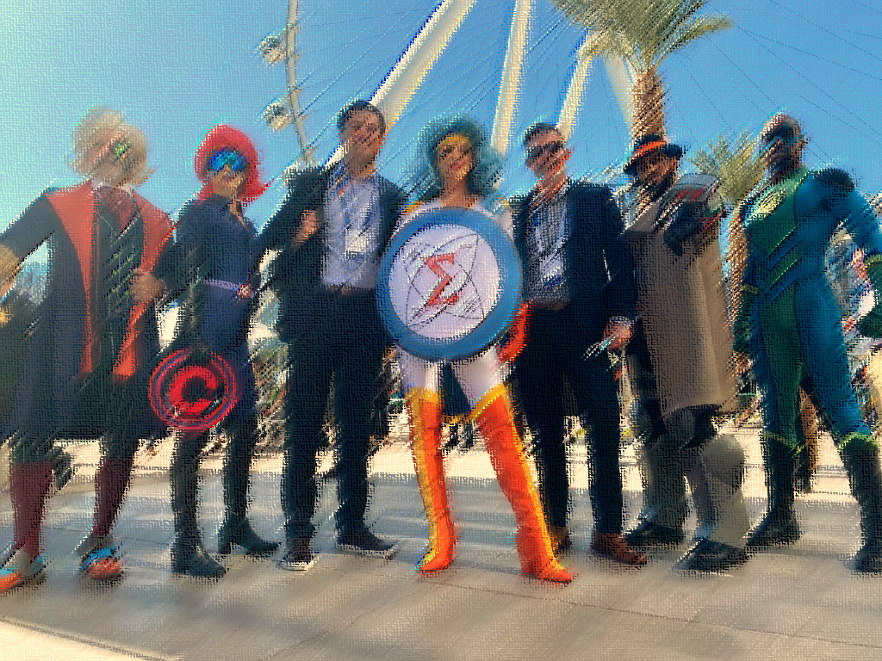
Captain Finance – ERP
Intangible Girl – Finance
Forecasting Man – Financial Planning
Inspector Sku – Inventory Management
Doctor Cogs – Supply Chain Management
NetSuite, introduced advancements that would improve how modern businesses work.
Various characters were dubbed the “Superheroes of Finance”

Slide 55
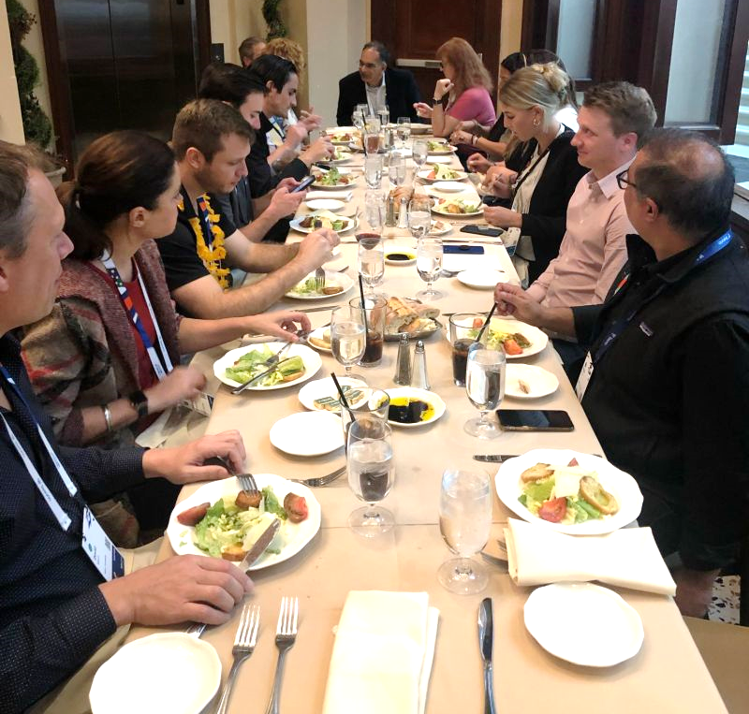
Wine & Dine with the Folio3 Crew
We enjoy gathering with our colleagues, clients, and prospects at SuiteWorld to applaud the firm's wonderful achievements. Don't miss out on this chance to dine with like-minded individuals and get a fresh perspective.

Slide 56

Contact us
Email Address
netsuite.sales@folio3.com
Phone Number
+1 (408) 365-4638
Website Address
netsuite.folio3.com

Slide 57
THANK YOU

