Slide 1


Working with NetSuite

Slide 2
Agenda
Understanding NetSuite
How Does NetSuite Work?
Is NetSuite Easy to Use?
Five core features of NetSuite
Products Overview
How to use NetSuite?
NetSuite Can Be Customized to Meet Your Exact Requirements
Improving business performance with NetSuite
NetSuite Configuration
NetSuite Implementation
NetSuite Support
How to Learn NetSuite?

Slide 3
Understanding NetSuite
We are the top cloud ERP business software solution from start-up to enterprise.
NetSuite provides a single cloud platform that businesses can use to manage their entire business processes, from supply chain management to customer service.

Slide 4


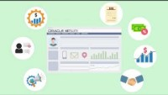

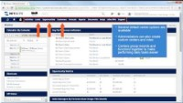
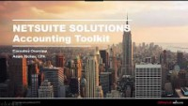
Browse through these videos to easily navigate within NetSuite
Quick NetSuite Guide
Product demo
CRM Introduction
Dashboard
Navigating NetSuite
NetSuite Accounting toolkit overview

Slide 5
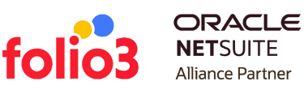
How to use NetSuite?
We'll go through a few components and features of NetSuite ERP and demonstrate how it may help you streamline your business processes.

Slide 6
How To Enable Non-G/L Changes To Closed Periods
You might want to change a PO number or add a memo without crediting and reissuing the invoices. Furthermore, this setting is necessary for some ISV solutions to sync their data with locked and closed periods.
How to Enable the Updated NetSuite Bank Reconciliation Process
It can be challenging to streamline your bank reconciliation procedure, which is where NetSuite comes in. You can monitor and manage all your bank accounts with NetSuite's comprehensive platform from a single location. NetSuite is a perfect option for busy executives and professionals because it is user-friendly and straightforward.

Slide 7
Automated Order-to-Delivery Cycle with NetSuite
Your order-to-delivery process may function more efficiently and effectively than ever with the correct automation. From order entry to shipping and tracking, NetSuite provides a wide range of automation capabilities that can help optimize your order processing. You can save time and money while enhancing the efficiency of your order-to-delivery process by automating it.

Slide 8
Renaming Records in NetSuite
One of NetSuite's cloud-based ERP software's most crucial features is the ability to make changes quickly. Analyze record renaming in NetSuite to change your data and transaction names from NetSuite's standard nomenclature to ones that fit your company's language.
Saved Searches: Powerful and Underutilized
Any NetSuite account must include saved searches. Using any device, you may quickly and effortlessly access your data and business processes. NetSuite stores your searches, so you don't have to repeat them whenever you run a report from a primary preceding assignment or are working on a paper from home and need to refer to your work from the office.

Slide 9
From AdWords to NetSuite - Implement Pay Per Click Campaign data into CRM.
Pay Per Click data could now be imported directly into NetSuite CRM using a customized integrated marketing solution. The lead generation process gains vital insight by adding additional critical elements like campaigns and keywords with metrics like clicks, prices, and conversion rates. This makes it possible to create reliable reporting using just one of the software.
SuiteScript and SuiteFlow
Users can build and share code with other developers more easily with NetSuite's SuiteScript and SuiteFlow programming languages. SuiteScript is a flexible programming language that may be applied in various sectors, including healthcare and finance. With the aid of the visual programming language SuiteFlow, users may generate and share code with other developers more easily.

Slide 10
Automated Customer Statements
Customer statement generation, which automatically sends statements to customers each month, is one of NetSuite's core features. This article will show you how to set up and operate NetSuite's customer statement generator so you may boost your bottom line and streamline your customer support procedure.
Use Statistical Accounts for Expense Allocations
Use statistical accounts for efficient budget allocation since they are a critical element of accounting. A company's financial success is significant, and making intelligent decisions requires understanding where your money is going.

Slide 11
Custom NetSuite Solutions: Serialized Number Tracking
Any efficient supply chain management solution must include serialized number tracking. Serialized numbers are identifiers that continuously identify a product or shipment. By tracking serialized numbers, you can ensure that goods are delivered to your warehouse in good shape. NetSuite offers serialization options to make this process simple and effective.
Building Customizations for NetSuite
Robust ERP software like NetSuite can help you grow your company. It's essential, though, to avoid relying on the specified characteristics. Discover how to modify your NetSuite account to meet your unique demands.

Slide 12
Inventory Transfers in NetSuite
One of the significant expenses for enterprises is inventory; therefore, it's crucial to manage it well. Transfers are one way to achieve this since they can assist in tracking where the list is located and when it must be delivered.
Importing Customer Records With NetSuite
The best tool for importing client records is NetSuite. Using NetSuite, you may quickly collect data from your client base and incorporate it into your accounting and marketing processes. Automating your operations, increasing data accuracy, and reducing the time needed to update your records are all benefits of importing customer records.

Slide 13
NetSuite Commissions and Outsourced Payroll
The NetSuite Incentive Compensation module includes a feature set that serves various compensation requirements, including the sales commission capability. Pay commissions using the NetSuite payroll module or the regular Accounts Payable procedure (Vendor Bills) is simple.
3 NetSuite Reporting Features You Can’t Live Without
There are three vital reporting functions in NetSuite that can help you better understand the data and performance of your firm.
Financial Segmentation
Slicing and Dicing of Financial Reports
Financial Report Customization

Slide 14

Create Custom Records
Custom records might be helpful whenever you require a procedure or functionality not built-in to NetSuite by default. You can design custom fields, lists, and unique connections with other NetSuite records and transactions using dynamic, adaptable building blocks called custom records.

Slide 15
Add record type prefixes to global search keywords to limit search results, followed by a colon (:) or a carat ().
The record will be opened in "Edit" mode if the search prefix's first letter is capitalized; "View" mode if the prefix is entered in lower case.
For best results, keywords should be at least three characters long and no more than 32 characters.
Global search defaults to excluding inactive records.
When utilizing numeric keywords, use the wildcard '%' so that the global search only displays results that match the term.
Search using quotation marks to get exact text matches (").
By checking the "Global Search" box on the custom field record, custom fields with the selected Store Values can be searchable globally.
A record will default be opened in view mode if a search only yields one result. Users can enable a preference that will display the results as though there were several search results.
NetSuite Global Search Tips
Everyone like shortcuts, right? Did you know that NetSuite has many obscure shortcuts that can help you avoid making unnecessary clicks? Our NetSuite professionals have put together a few tips and tricks for all NetSuite users.

Slide 16
Five Core Features of NetSuite

Slide 17
Unified view of the business
Native integrations
NetSuite allows any corporation to run its entire business from one platform. Rather than using different software for finance, supply chain, manufacturing, HR, and ecommerce, NetSuite combines them into one system using one database. Employees may simply log on to monitor the status and performance of any operation component with a few clicks.
NetSuite applications pull data from and feed information into the central database to prevent information from being split across multiple databases. NetSuite's built-in modules remove the need for unreliable or insufficiently dynamic third-party integrations. The unified architecture delivers a consistent user experience across all modules, lowering training time and enabling people to become productive.

Slide 18
True Cloud
NetSuite was created and optimized for the cloud. Many “cloud” ERP programs are hybrid cloud—essentially, on-site software modified for internet access. Such programs suffer the same difficulties as traditional systems, including version lock, sluggish upgrades, and lack of scalability. NetSuite is a multi-tenant, vendor-managed cloud solution with unlimited potential for expansion.
Notes:
Note: Insert your picture by clicking on the Picture Place Holder Icon, then send it back!

Slide 19
Deep reporting capabilities
NetSuite’s extensive reporting capabilities are fueled by the data flowing from departments and business units into the platform. Thanks to the system's built-in reporting tools, users can obtain reports on anything they want to measure or understand. NetSuite also gives employees, managers, and executives quick information via role-based dashboards.

Slide 20
Built-in flexibility
NetSuite can accommodate a wide range of organizations thanks to its versatility. In addition to its impressive features, the platform can be tailored to meet the needs of different companies, whether a multinational corporation with six subsidiaries or a startup working on your first item; suite cloud apps and tools can be customized to fit your procedure's corporate structure.

Slide 21
Products Overview
NetSuite can meet various organizations' demands because it includes many functions and procedures focused on critical business issues. Because it has a wide range of modules dedicated to crucial business functions and processes, NetSuite can adjust to the demands of a diverse range of organizations.

Slide 22
Finance
Notes:
Note: Insert your picture by clicking on the Picture Place Holder Icon, then send it back!

Slide 23
Financial Management
NetSuite provides financial management services that handle many bookkeeping jobs, such as updating the general ledger, tracking accounts receivable and payable, and submitting invoices. This module reduces the time required to close monthly and creates vital financial reports for regulatory and statutory reporting. It supports complex revenue recognition standards and consolidates financial statements from subsidiaries, including foreign subsidiaries, by real-time currency conversion.
Global Business Management
NetSuite OneWorld allows multinational and multi-subsidiary businesses to manage their entire operations using one system. With support for multiple currencies, languages, tax codes, and reporting requirements, OneWorld can meet the needs of global businesses. Decision-makers may view the company as broad or narrow a scope as they desire, thanks to regional, national, and international financial roll-ups.
Notes:
Note: Insert your picture by clicking on the Picture Place Holder Icon, then send it back!

Slide 24
Planning and Budgeting
Business leaders can create departmental or companywide budgets and forecasts using NetSuite Planning and Budgeting. The module also provides financial analysts with statistical models that allow them to run what-if scenarios that forecast revenue, expenses, and more based on various possible outcomes.
Billing
NetSuite SuiteBilling assists enterprises manage financial matters by reducing the complication of managing finances in many contemporary businesses. It supports a variety of economic structures, from transactions to subscriptions to usage. NetSuite SuiteBilling minimizes the number of work firms has to handle in financial matters. This module helps firms remain profitable and flexible.
Notes:
Note: Insert your picture by clicking on the Picture Place Holder Icon, then send it back!

Slide 25
Operations
Notes:
Note: Insert your picture by clicking on the Picture Place Holder Icon, then send it back!

Slide 26
Inventory Management
Order Management
NetSuite Inventory Management automatically updates inventory levels across all channels and locations in real-time, saving time and effort. The inventory management module may use sales data to set reorder points and alert purchasing managers when to place replenishment orders.
NetSuite Order Management handles the entire order lifecycle, from receiving through delivery, at each step — as the orders are placed, released, shipped, and settled with the customer. This module can automate order processing and fulfillations across channels based on pre-defined guidelines.

Slide 27
Procurement
NetSuite Procurement can increase the efficiency of the complete pay-to-purchase process by reducing time and money. Customers can keep track of approved vendors' quotes, automate purchase orders by collecting quotes and monitor performance and expenditure based on granular monitoring. Vendor self-service and expedited payments may also be enabled.

Slide 28
Warehouse Management System (WMS)
NetSuite WMS builds on the system's inventory management functions, adding functionality for putaway, order picking, barcode scanning, and returns authorization. The WMS module can be used on mobile devices to direct warehouse workers through receiving, picking, and counting cycles.

Slide 29
Demand Planning
NetSuite Demand Planning can help determine future demand for products and services based on historical data, current opportunities, or imported sales forecasts. The module can employ the moving average, linear regression, or average seasonal approaches.
Manufacturing
NetSuite Manufacturing is built for organizations that manufacture goods. The module assists in production planning and execution, shop-floor management, and monitoring production to obtain insights and improvement opportunities. The item ensures you have the appropriate materials and parts in the correct location at the right time and enables managers to track work orders.

Slide 30
Customers
Notes:
Note: Insert your picture by clicking on the Picture Place Holder Icon, then send it back!

Slide 31


Customer Relationship Management
Commerce
NetSuite CRM provides a 360-degree look at customers. Sales force automation technologies help expedite the lead-to-cash process by managing information, quotes, and sales. Forecasting tools use data from past sales to forecast future sales more. Customer service data, like sales history and active support cases, is also merged into the CRM application.
NetSuite SuiteCommerce allows businesses to create outstanding omnichannel shopping experiences. The application provides companies with a platform for creating mobile-friendly ecommerce sites with simple tools. Multi-channel, multi-location businesses can unite SuiteCommerce with the SuiteCommerce Instore point-of-sale application to integrate all transactions and visits into one ecosystem.

Slide 32
Additional Capabilities
Notes:
Note: Insert your picture by clicking on the Picture Place Holder Icon, then send it back!

Slide 33
Professional Services Automation
SuiteApps
Payroll
Having access to extensive collections of apps developed by Oracle NetSuite and partners that provide additional functionality or integrations with other SaaS solutions is one of SuiteApps. NetSuite SuiteApps are available in virtually any business sector, and most run inside NetSuite.
NetSuite Payroll processes paychecks, adjusting earnings, deductions, taxes, bonuses, and paid time off to account for federal tax disparities. Businesses can pay employees directly or print checks, file payroll taxes, and create W-2s and 1099s for employees using the module.
NetSuite PSA solutions are geared toward services companies or service divisions within product companies. This system provides project and resource management, billing, time and expense management, and project accounting services.

Slide 34
Human Resources
Analytics
NetSuite's HR system, SuitePeople, uses human resources data throughout the suite. This solution stores personnel information aids new hires in joining, keeps track of promotions and cash pay changes, and assists employees with requesting time off. Employees may view directories and organization charts using self-service tools, and managers may review performance with their supervisors.
SuiteAnalytics utilizes all data in the NetSuite platform to provide enhanced insights, from summary to transaction levels. The SuiteAnalytics workbook enables you to construct custom filters and visualizations based on previous investigations and data. Simple drag-and-drop tools allow for quick answers to urgent questions - there are no coding or complex queries.

Slide 35

How Does NetSuite Work?
NetSuite is a cloud pioneer and remains fully committed to that model. It does not offer on-premises options. All NetSuite solutions are delivered via the cloud in a subscription model. NetSuite was a pioneer in the cloud, and it has not been forced to change its cloud architecture. As a multi-tenant cloud solution, all customers automatically run on the same software and receive up-to-date versions. Data is protected and stored separately on the server. Everything runs on the same code because everything is connected to the same hardware.

Slide 36
Is NetSuite Easy to Use?
NetSuite's user-friendly interface and numerous customizable modules make it appropriate for organizations of all sizes. The interface is simple to comprehend, and the modules are intended to make your experience as seamless as possible. Most experts and novices find it simple to learn, even independently.
NetSuite also has an online help center that provides users with step-by-step instructions for every feature in NetSuite so they can begin immediately.

Slide 37
NetSuite Can Be Customized to Meet Your Exact Requirements
NetSuite SuiteCloud platforms provide customers and partners with additional functionality and customization. Because of today's and tomorrow's shifting business requirements, organizations can meet current and future challenges without the threat of version lock. All customizations, regardless of platform upgrades, carry over.

Slide 38
Breakdown of SuiteCloud applications and developer tools

Slide 39
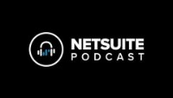

Slide 40
Customizations
It is much easier to create custom fields, forms, records, and roles with SuiteBuilder. Companies can modify their system to match their organizational structure and language usage with SuiteBuilder.
Process Automation
With SuiteFlow, developers can create custom workflow units for specific business functions. They can automate processes like lead nurturing and sales discounts using an easy-to-use interface.
Platform Development
NetSuite developers and SuiteScript administrators can create virtually any new application or procedure using this tool. For example, JavaScript application scripting is how they write applications, and SuiteScript can debug their code.

Slide 41
Application Distribution
By using SuiteBundler, partners can make it easier for customers to apply modifications to different accounts by reducing the time required for deployment. SuiteBundler makes it easier for partners to send out new versions of these applications to customers.
Internationalization
Create an environment that feels natural for end-users and administrators regardless of the language, currency, or accounting system used in your global company or overseas subsidiary.
Performance Monitoring
To ensure business continuity and keep users productive, performance health dashboards monitor systems health and include tools to identify root cause issues affecting product experience quickly.

Slide 42
Improving business performance with NetSuite

Slide 43
LEVERAGE INCREASED VISIBILITY AND REPORTING DATA
Your employees in every business unit can access the same data at any time, from any location, thanks to NetSuite ERP. Every business unit at many companies uses a different software platform that can't successfully communicate with the others.
It's possible that your team is digging through spreadsheets or constantly importing and exporting data to order to see the big picture. Not to mention the additional expenses (and hassles) caused by incompatible systems.
Consider these cost advantages:
Real-time data
Compliance data
Data visualization
Mobile access
Accurate data

Slide 44
IMPROVE ORDER MANAGEMENT
The order management module in NetSuite ERP will astonish you if you search for a powerful solution to deliver top-notch business efficiency. With a system that connects the sales, finance, and fulfillment teams in an effective and accurate process, you'll save hours of staff investment. Automated processes also facilitate quick billing and payment to improve your cash flow, lower errors, and please your clients.

Slide 45
STREAMLINE PRODUCTION MANAGEMENT
Effective production management and clear insight into manufacturing are essential for you and your company. But how many ERPs enhance a business's operational efficiency? You can have the real-time visibility you need to manage the manufacturing process from beginning to end and make clever modifications using NetSuite ERP process automation will increase efficiency, enable on-time delivery of your products, and lower expenses.

Slide 46
OPTIMIZE YOUR PURCHASING POWER
The ERP procurement solution for NetSuite can simplify the purchasing process. When you and your business have visibility into total expenditures and vital information on vendor performance, you can make modifications, as necessary. As a result, you may purchase goods and services quickly, reduce prices, and spare your employees significant time (and worry).
NetSuite ERP procurement solutions
Vendor management
Purchase requisition
Purchase order management
Purchase approvals

Slide 47
NetSuite Configuration
NetSuite is built customer-centric, leveraging the company's strengths to support business growth.
NetSuite's experts join the financial management specialists who are well acquainted with the company's business and industry in forming a customer-specific team of experts.
Our experts collaborate with customers to review core business processes, support processes, and future goals at the highest level. A workshop is arranged so we can focus on understanding the customer's needs and how NetSuite can help the customer simplify their process.

Slide 48
NetSuite Implementation
A new business platform and processes are significant changes for the organization, and we play an essential role in assisting our customers with change management throughout the process. Based on our understanding of the customer's business and processes, we prepare the necessary materials and draw up a plan in the configuration phase.

Slide 49
steps involved in the deployment process
01
02
03
04
05
Kick-off
Business mapping
Construction and validation
Implementation
Optimization
Before beginning a project, we collaborate with stakeholders to ensure that everyone understands the project goals and timetable and concurs with the project's progress.
We go through the customer's firm and create an accurate understanding of the different processes, so we can further plan the process development to support the company's growth strategy.
We configure the system and create enterprise process models. On this basis, we conduct the necessary analyses and tests to ensure that the software supports the goals of all users.
You will be granted access to NetSuite. We further provide user training as required.
We continue to work with the possible optimizations, and after the final validation, the system is ready to be used, and we can then roll to the live phase.

Slide 50
06
GO LIVE!

Slide 51
Disruption management
Change and development management
Administrator support
Admin Support offers instruction on utilizing NetSuite for little and big problems. For instance, such assistance could be necessary if a user starts using NetSuite for the first time without prior knowledge of the program.
Disruption Management refers to help designed to answer fast to disturbances in the NetSuite environment.
Whenever we view a change as advantageous to a customer's business, we advise it. NetSuite is frequently improved as the customer's business evolves.
NetSuite Support
Our support services are designed to respond to our client's needs. Our service is more than just technical support; it's the collaboration of a multidisciplinary team focused on your business.

Slide 52
How to Learn NetSuite?
We offer tailor-made NetSuite training sessions, which include training on Standard NetSuite, on your customized NetSuite, and workflows.

Slide 53
OUR NETSUITE TRAINING BY DEPARTMENT
Operations
Management
We offer inventory, procurement, project management, sales, marketing, and after-sales training.
We provide the training your departmental leaders and directors need to monitor their company activity on NetSuite.
Finance
IT
We deliver our accounting unit the training they require: AP, AR, Bank reconciliation, month/year end, journal entries, fixed assets, and more.
We enhance your IT team's expertise in NetSuite concerning security, user limitations, audit trails, reports, dashboards, and saved searches.

Slide 54
NETSUITE TRAINING FOR AUDITORS AND ACCOUNTING FIRMS
Operations
Management
You will become familiar with the NetSuite process flows and execute test case scenarios. Marketing, sales, after-sales, staff activities, inventories, purchasing, project management, and manufacturing are a few of the subjects addressed.
You will become an expert at using your dashboards, reports, and saved searches to provide your NetSuite customers with unheard-of reporting levels. We will teach you about performance evaluations, email notifications, approval protocols, and report scheduling.
Finance
IT
We'll teach you about the chart of accounts, different currencies, accounting periods, payables and receivables, bank reconciliation, month-end closing procedures, revenue recognition, fixed assets, and financial reporting setup.
We instruct consultants to alter forms, add fields, and make new tables. We provide best practice guidance on system security, audit trails, and personnel limits. Additionally discussed are SuiteScript, workflows, and integration.

Slide 55
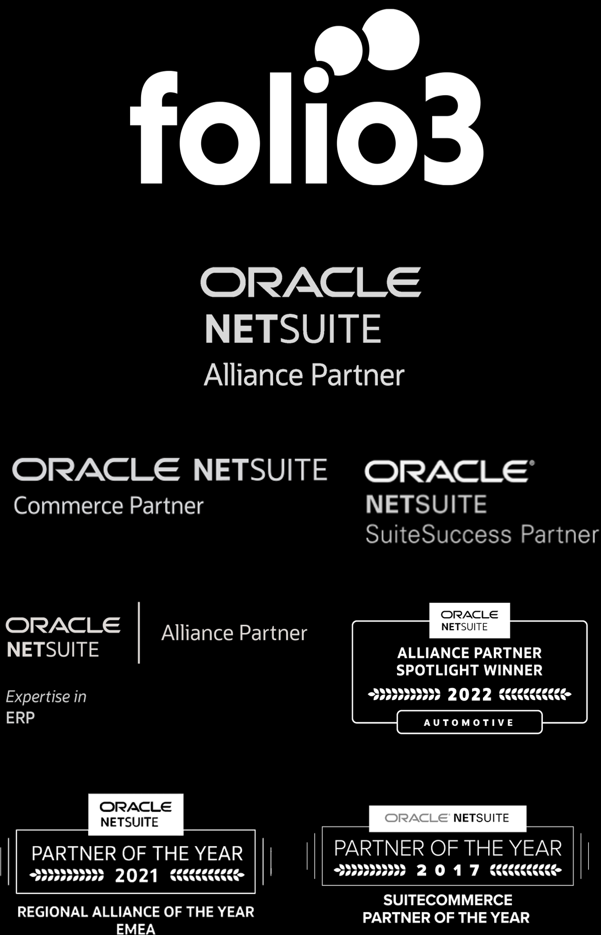
About Folio3
We are a Certified NetSuite Alliance Partner
We are an Experienced NetSuite Partner with Deep Domain Expertise

Slide 56
Contact us
Email Address
netsuite.sales@folio3.com
Phone Number
+1 (408) 365-4638
Website Address
Netsuite.folio3.com

Slide 57
Thank you

