Slide 1
Mastering Apparel Manufacturing
Everything You Need to Know About Folio3's Nstitch Solution

Slide 2
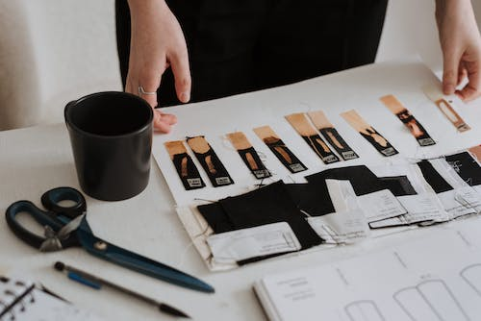
Agenda
Apparel Manufacturing
Challenges That Fashion And Apparel Businesses Face In The Manufacturing Process
Folio3's Nstitch Manufacturing Solution Is A Way To Address These Challenges.
What Is Folio3's Nstitch Manufacturing Solution?
About NetSuite
The CMT Process
How Does Folio3's Nstitch Manufacturing Solution Work?
The Benefits Of Using Folio3's Nstitch Manufacturing Solution
How Is Nstitch Solution An Effort Reducer?
Naked Wardrobe - (A Case Study)
Conclusion

Slide 3
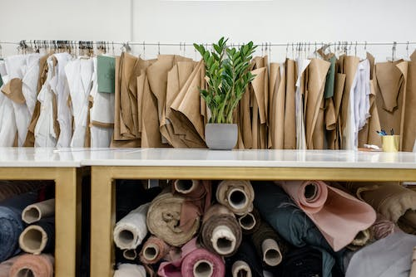
Apparel Manufacturing - A brief overview
The apparel manufacturing industry is A significant global market, with numerous companies and brands operating worldwide. The industry employs many professionals, including designers, pattern makers, cutters, sewers, quality control specialists, and logistics experts. It’s the process of designing, producing, and distributing clothing and accessories, including design, pattern making, cutting and trimming fabric, sewing and assembling garments, quality control, and distribution.

Slide 4
Challenges that fashion and apparel businesses face in the manufacturing process
Inaccurate Material Planning
This can lead to an insufficient supply of materials, production delays, increased costs, or decreased product quality.
Lack of control and Visibility
A company lacks the tools or resources to monitor and manage its operations effectively, leading to a lack of control over various processes, including production, inventory, supply chain, and financial management.
High Production cost
Encounter significant expenses during manufacturing, often struggling to balance quality with cost-effectiveness.
Notes:
Note: Insert your picture by clicking on the Picture Place Holder Icon, then send it back!

Slide 5
Quality Control
Speed-to-Market
managing outsourced vendors
Ensuring all garments meet the company's design, materials, and workmanship standards can be difficult
Fashion businesses must be agile and responsive to consumer demand, A delicate balance of speed and accuracy is required.
Communication barriers between you and the vendor make understanding each other's expectations and needs challenging.

Slide 6
Folio3's Nstitch Manufacturing Solution Is A Way To Address These Challenges
Notes:
Note: Insert your picture by clicking on the Picture Place Holder Icon, then send it back!

Slide 7
What Is Folio3's Nstitch Manufacturing Solution?
Folio3 has developed a comprehensive ERP solution for the apparel and fashion industries, leveraging NetSuite's robust engine as a foundation. The solution provides a one-stop shop to customize and optimize their ERP requirements.

Slide 8
One Stop-Shop Solution
The solution takes order lines such as sales orders, transfer orders, or customized criteria to provide a high-level overview of the process.
It selects specific lines to generate a production order. The production order is the foundation for manufacturing finished goods based on the items.
The production process includes various steps, such as cutting, sewing, grading, QC, and others, while recording service charges and costs in NetSuite and updating the raw materials inventory.
After successful production, the inventory of finished goods is increased in NetSuite's defined location, fulfilling the purpose of wholesale manufacturing.
This solution is versatile enough to handle full-package production (single purchase from a vendor) and wholesale manufacturing as part of the NStitch solution.

Slide 9
Cut-Make-Trim is a widely used term in the clothing industry.
It is a three-stage manufacturing process in which an apparel factory takes the customer's designs and creates the final product.
First, the fabric is precisely cut to its pattern during the' Cut' stage and prepared for sewing.
Secondly, skilled workers use specialized techniques and machines to sew the garment pieces together in the 'Make' stage, ensuring each stitch is flawless.
In the 'Trim' stage, garments undergo final inspection, and imperfections are removed before the product is packed for shipment.
Finally, Fashion businesses must prioritize accuracy, craftsmanship, and attention to detail in each stage to deliver high-quality garments that meet customer expectations.
The CMT process
Notes:
Note: Insert your picture by clicking on the Picture Place Holder Icon, then send it back!

Slide 10
Folio3's NStitch manufacturing solution is a comprehensive ERP (Enterprise Resource Planning) system tailored to the needs of the apparel and fashion industries.
It begins by taking in order lines such as sales orders, transfer orders, or customized criteria and selects specific lines to generate a production order that serves as the foundation for the manufacturing process of finished goods.
Then based on the items to produce, the production process involves various steps defined by the client, such as cutting, sewing, grading, QC, etc.
It process records service charges and costs in NetSuite and updates the raw materials inventory as needed.
After producing finished goods, NStitch solution increases the inventory of finished goods in NetSuite's defined location, fulfilling the purpose of wholesale manufacturing.
How does Folio3's NStitch manufacturing solution work?
Notes:
Note: Insert your picture by clicking on the Picture Place Holder Icon, then send it back!

Slide 11
Key features
Detailed reports and analytics, enabling Brands to make informed production and resource management decisions.
Offers real-time tracking and monitoring of the production process, helping businesses to identify and address issues quickly.
Automation to enhance efficiency and productivity.
It is highly scalable and can grow and evolve with the needs of the business, providing long-term value and sustainability.
During production, records service charges and costs in NetSuite and updates raw materials inventory as needed, helping businesses manage their resources effectively.

Slide 12
The Benefits of Using Folio3's NStitch Manufacturing Solution
Order tracking made easy
Gain maximum control and visibility
Inventory control automated
Quality control
Quicker delivery.
Cost-effective Solution
Better Communication
Improved profitability
Easy to use

Slide 13
How is NStitch Solution an effort reducer?
Notes:
Note: Insert your picture by clicking on the Picture Place Holder Icon, then send it back!

Slide 14
Automated Production Order Generation
Automatically generates production orders based on sales orders, transfer orders, or other customized criteria, faster turnaround times.
Defined Production Steps
Ensures that each production stage is optimized for efficiency and that the final product meets the client's quality standards.
Accurate Inventory Management
Updates raw materials inventory in real-time, ensuring the manufacturer can plan for potential material shortages and reduce lead times.
Easy Monitoring
Provides a high-level overview of the manufacturing process, enabling easy production progress monitoring.
Customizable
This solution is fully customizable to suit the specific needs of each business.

Slide 15
A great advantage for Manufacturers
Increased Efficiency
Streamlines the manufacturing process, reducing the time required to produce finished goods.
Improved Quality Control
The defined production steps and automated recording of service charges and costs ensure that the final product meets the client's quality standards.
Cost-Effective and Scalable
Helps manufacturers to optimize their production lines and is scalable.

Slide 16
Naked Wardrobe - (A Case Study)
Naked Wardrobe, a fashion brand that strives to empower women of all body types, was established by three sisters. With a focus on offering trendy clothing, the company has experienced rapid yearly growth for over a decade due to its dedication to producing high-quality products, providing unique options, and keeping up with the latest fashion trends.

Slide 17
The Challenge
The current ERP system Naked Wardrobe utilized had limited functionality and could only handle basic tasks such as shipping, inventory management, and frontline operations. Additionally, the company is using separate software, such as ShipStation for parcel shipment and Magento M1 for eCommerce management. Relying heavily on manual processes to run operations negatively impacts productivity and growth.
The Solution
Naked Wardrobe was able to carry out its daily financial, procurement, manufacturing, inventory, sales, and CRM functions all in one place with the help of Folio3's implementation of NStitch Software.

Slide 18
The Result
With the implementation of NStitch by Folio3, Naked Wardrobe could streamline its day-to-day financials, procurement, manufacturing, inventory, sales, and CRM functions. This resulted in increased ease, transparency, and flexibility in their processes. Additionally, the teams were able to have clear visibility into the various stages of manufacturing, such as cutting, sewing, and embroidery. By utilizing a single platform instead of multiple tools, tasks could be completed with just a few clicks, saving the company significant time.

Slide 19
Conclusion
Folio3's NStitch manufacturing solution offers several benefits to fashion businesses, including streamlined production processes, reduced lead times, improved efficiency, increased profitability, and enhanced quality control. By leveraging its automated production order generation process, customizable manufacturing steps, and seamless integration with NetSuite's ERP system, fashion businesses can optimize their production lines, reduce costs, and effectively meet customer demand. Case studies of successful implementations, such as Naked Wardrobe, demonstrate the tangible benefits of the solution in real-world scenarios.

Slide 20
If you're an Apparel Brand looking to improve your manufacturing processes and overcome challenges in the industry, you might want to consider Folio3's Solution. Let us show you how to be best positioned to reap all the benefits of implementing Folio3’s NStitch Solution.
With its extensive features and customizable options, the solution can help you streamline your production line and achieve tremendous success in your business.

Slide 21
Contact Folio3 today
+1 (408) 365-4638
netsuite.folio3.com
netsuite.sales@folio3.com
Notes:
Note: Insert your picture by clicking on the Picture Place Holder Icon, then send it back!

Slide 22
Thank you
Notes:
Note: Insert your picture by clicking on the Picture Place Holder Icon, then send it back!

