Slide 1


Optimizing Production Planning with a Holistic Apparel and Fashion Software

Slide 2
The Significance Of Production Planning For Apparel Businesses: An Overview
Key Benefits To Effective Production Planning For Apparel Businesses
Stages In Apparel Manufacturing Production Planning
Challenges In Production Planning For Businesses.
How Folio3’s Nstitch Solution Can Help Optimize Production Planning
NStitch Specialized Features That Can Aid In Production Planning
How Can NStitch Help Businesses Overcome Production Planning Challenges?
Conclusion
Agenda

Slide 3

The Significance of Production Planning for Apparel Businesses: An Overview
Production planning is a critical process for apparel businesses, as it helps them to manage their resources and meet their production goals in a timely and cost-effective manner. This process involves determining the number of products to be manufactured, the materials required, the time frame for production, and the allocation of resources to ensure that production is completed on time and within budget.

Slide 4
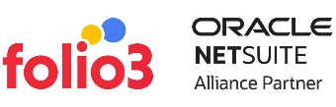
Key Benefits To Effective Production Planning For Apparel businesses
Meeting customer demand
Optimizing resources
Improving quality
By planning production, apparel businesses can ensure enough products to meet customer demand, avoiding stock shortages and lost sales.
Production planning helps businesses to optimize their use of resources, including raw materials, labor, and equipment.
Effective production planning can help improve the quality of apparel products by ensuring they are produced consistently and to the required standards.
Managing costs
Reducing lead times
Production planning can help by identifying areas where savings can be made, such as improved efficiency or better sourcing of raw materials.
Apparel businesses can reduce lead times, which can help to improve their responsiveness to customer demand and reduce the risk of stockouts.

Slide 5
Stages In Apparel Manufacturing Production Planning
Designing
Sourcing Materials
Creating Patterns and Samples
Planning the Production Process
Performing Quality Control
In this stage, designers create sketches and technical drawings of the garments they want to produce.
Once the designs have been finalized, the materials needed to make the garments are identified, sourced, and ordered.
Samples are created to test the design and fit, allowing manufacturers to refine and ensure the final product meets their standards.
Based on the results of the sample testing, the production process is designed, including creating cutting plans, sewing instructions, and finishing techniques.
Once the garments are produced, they are inspected for quality control before being shipped to retailers or consumers.

Slide 6
Challenges In Production Planning For Businesses
Forecasting demand
Capacity planning
Accurately predicting demand for a product or service can be a challenging task, as it is affected by various factors, such as seasonal trends, consumer behavior, and market changes.
Ensuring that the production capacity matches the demand for a product or service can take time, as changes in demand or unforeseen events can lead to overproduction or underproduction.
Resource allocation
Supply chain disruptions
Allocating resources such as labor, machinery, and raw materials in the most efficient way possible can be challenging, especially when dealing with complex production processes and limited resources.
Supply chain disruptions such as delays in shipping, shortages of raw materials, or unexpected demand can significantly affect production planning and cause delays and inefficiencies in the production process.

Slide 7


Challenges in production planning for businesses
Technological changes
With the rapid advancement of technology, businesses need to continuously adapt and update their production processes with new technology to remain competitive and efficient.
Budgeting
Balancing production costs with the price of the product or service can be challenging, especially when dealing with fluctuating costs of raw materials and labor or unexpected changes in market conditions.

Slide 8



How Folio3's NStitch Solution Can Help Optimize Production Planning
Folio3 offers its users numerous efficient and practical modules, facilitating their daily tasks. Among them is the production management module designed explicitly for production-related activities. It allows users to generate sales orders, schedule work orders, manage product costing, and complete order fulfillment. With this manufacturing solution, Folio3 provides real-time visibility into each stage of the production process, empowering users to make informed decisions. Flexibility is required in Cut-Make-Trim (CMT) processes as each client has unique requirements, criteria for feeding items into the CMT process and costing formulas.

Slide 9

Features and tools that can aid in production planning
Custom Routing
With our NStitch solution, companies can efficiently manage various production steps, including cutting, sewing, and embroidery, as part of the production order. This allows for proactive measures to prevent delays and ensure timely customer deliveries.
Sourcing of Production Order
Production orders can be created against sales or transfer orders to meet customer requirements. Inventory levels are tracked to plan for seasonal demands proactively. Furthermore, conditions can be manually updated or changed at your convenience.

Slide 10
Make-to-Order
Make-to-Stock
Manual Creation
The system extracts sales order lines, creating production orders against those sales orders to fulfill customer demands.
The system extracts transfer order lines, enabling organizations to fulfill their make-to-stock requirements and build inventory to meet seasonal demands or needs in a specific location.
The system allows users to directly access the Production Order screen and select items and quantities to initiate production.
Our CMT Solution allows organizations to create production orders from the following sources.

Slide 11
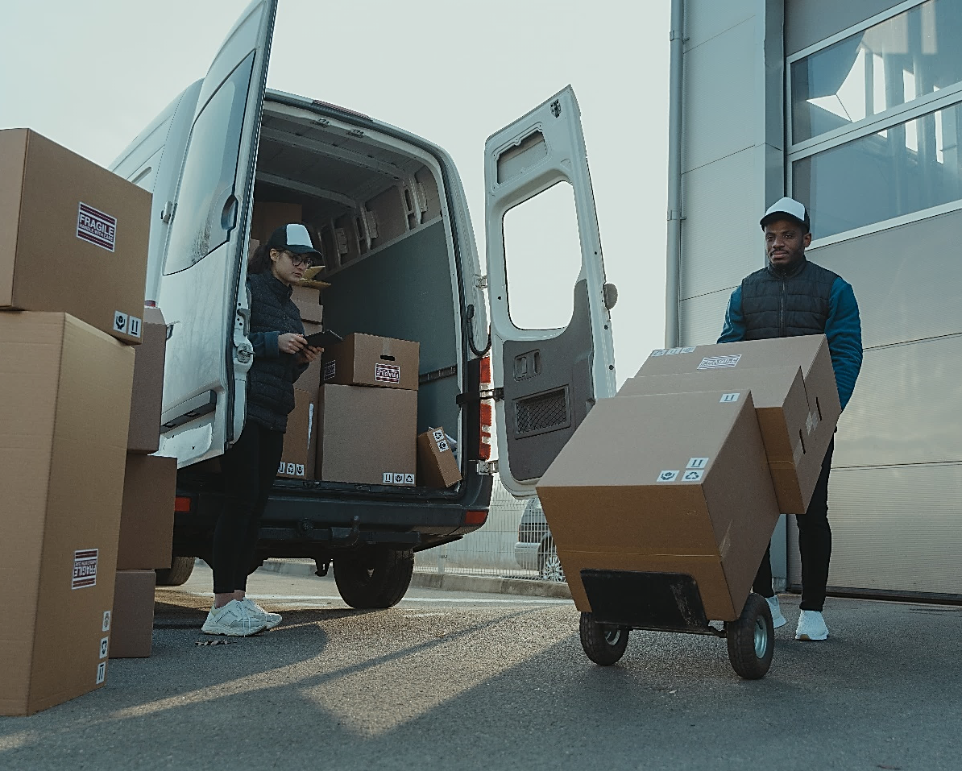
Automatically generate sub-production orders
Order
Cancellation
Within our NStitch Solution, sub-assemblies are fully supported. Suppose a sub-assembly is part of the finished assembly's bill of materials. In that case, the system will automatically generate a subassembly production order, which will be linked to the parent production order.
Canceling a production order is a breeze with our NStitch Solution; users can do so anytime. The system automatically transfers unused raw materials to the primary storage while assigning the Work-in-Progress (WIP) cost to the damage account.

Slide 12

Production Order Rework Functionality
Generate Purchase Orders for Outsourcing
Raw Material Transfer Order Generation
Our Nstitch Solution includes a re-work functionality that allows users to redo specific tasks in a production order if they were not completed correctly or require additional work. This feature ensures that production orders are completed accurately and efficiently.
It enables users to generate purchase orders for outsourcing services linked to the production order to record the outsourcing charges by the vendor. This feature ensures accurate calculation of the cost of the finished assembly.
The NStitch Solution automatically generates transfer orders for raw materials from the central warehouse to the vendor/production location. This enables organizations to plan for the timely delivery of raw materials to avoid production delays

Slide 13

Component Consumption Recording
Finished Goods
Cost Calculation
After each task is completed, the system allows users to record component consumption, which ensures an accurate inventory picture at any given time and absorbs the cost of components into the finished assembly produced by the production order.
The NStitch Solution calculates the cost incurred on the production order for a particular product. It distributes it to each quantity of finished assembly to ensure that all prices are absorbed and become a part of the produced finished assembly.
Accounting Entries
Generation
Cut Tickets & Cost Sheets
The tool records several journal entries through its operations to ensure that all labor and overhead charges are recorded and converted into product costs.
The NSitch Solution provides printed reports, including cut tickets and cost sheets, which help the production department to know what to produce and enable the organization to modify and re-engineer existing processes for cost-efficient production.

Slide 14


Additional features you can get on-demand
Lot Management
Our system provides lot management capabilities that enable you to efficiently track and manage items with lot numbers during component consumption and finished goods receiving processes.
Full-Service Production Management
Our software can efficiently manage full-package production processes, including purchasing finished goods from a single vendor and overseeing various production steps such as grading and quality control.
Product Repair Functionality
Customers can use our repair functionality to manage returned goods and perform necessary rework for resale.

Slide 15
How can Our tool help businesses overcome production planning challenges?
Production process streamlined
Repetitive tasks automated
Real-time visibility into production
Optimized operations
Customizable workflows
Effective inventory management
Improved collaboration and communication
Access to advanced analytics for better decision-making

Slide 16

Conclusion
Folio3's NStitch software is an excellent choice for production planning in the apparel industry. By leveraging this solution, apparel manufacturers can gain a competitive advantage in the marketplace and improve their bottom line. Overall, Folio3's NStitch solution is a must-have tool for any apparel manufacturer looking to stay ahead of the curve in today's fast-paced and highly competitive industry.

Slide 17
Get in Touch
+1 (408) 365-4638
netsuite.folio3.com
netsuite.sales@folio3.com

Slide 18
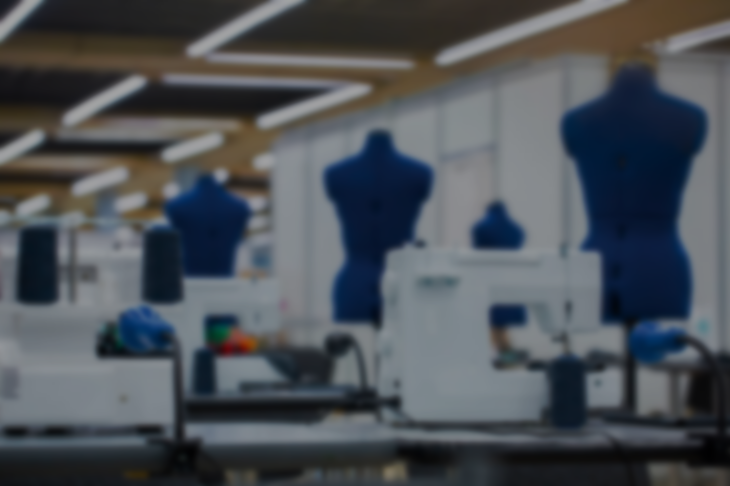
Thank You

