Slide 1
Boosting Operational Efficiency
Overcoming Manual Processes In Government Contracting With NetSuite

Slide 2
TABLE OF
CONTENT
Importance of compliance in the federal contracting industry
Hurdles Faced by government contractors
Role of an ERP System in addressing compliance issues
Streamlining Government Contractor Operations: Overcoming Tedious and Time-Consuming Manual Processes with Folio3
Achieve Compliance Excellence with Folio3

Slide 3
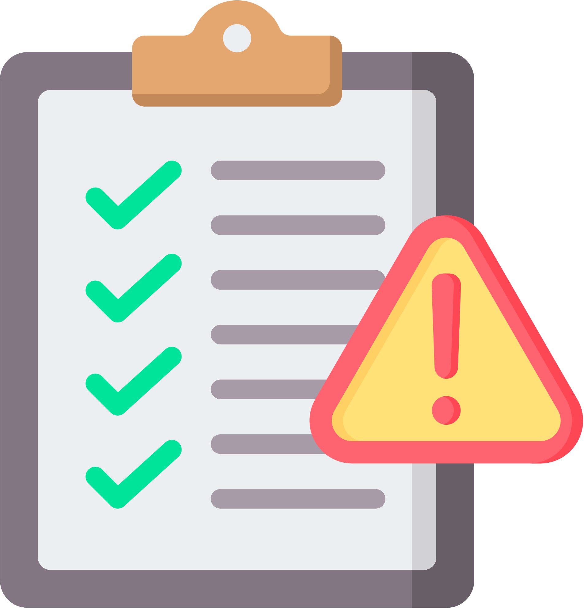
IMPORTANCE OF COMPLIANCE IN THE FEDERAL CONTRACTING INDUSTRY
LEGAL AND REGULATORY IMPERATIVES
Compliance ensures adherence to requisites, encompassing specific procurement rules, labor laws, security regulations, environmental benchmarks, and more.
MITIGATING PENALTIES AND LEGAL CONSEQUENCES
Non-compliance can lead to penalties, contract termination, suspension, and legal action. Upholding compliance helps mitigate risks and maintain a good reputation.
NURTURING BUSINESS RELATIONSHIPS
The federal government highly values contractors that consistently demonstrate compliance. Upholding compliance fosters a positive track record and increases the likelihood of securing future contracts.
PROMOTING ETHICAL AND TRANSPARENT PRACTICES
Compliance advocates for ethical conduct and transparent business operations. It ensures fair competition, prevents corruption, and safeguards the interests of taxpayers.

Slide 4
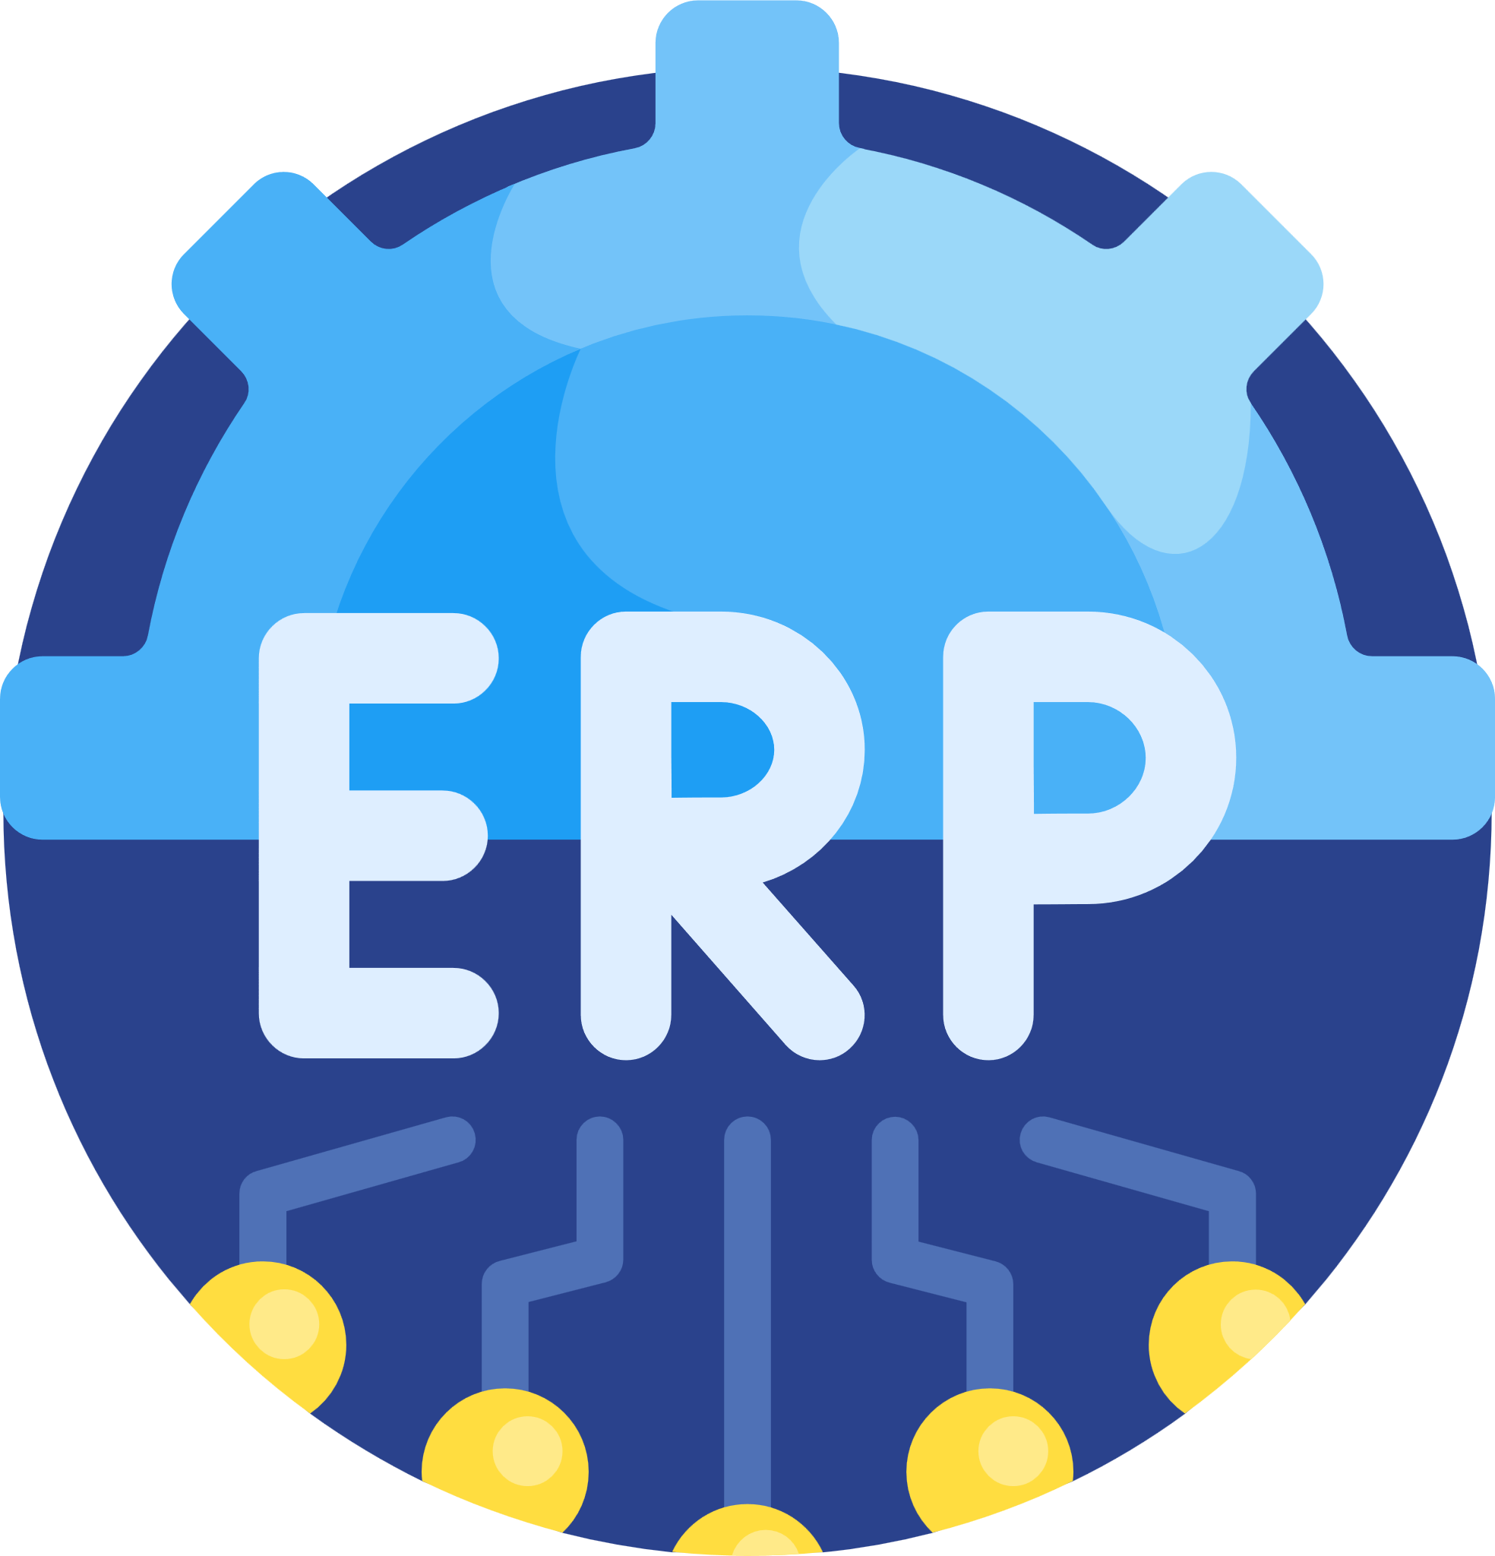
ROLE OF AN ERP SYSTEM IN ADDRESSING COMPLIANCE ISSUES
CENTRALIZED DATA MANAGEMENT
An ERP system provides a centralized platform for proficiently managing and storing contract-related data, compliance documents, and records.
AUTOMATION AND PROCESS STANDARDIZATION
ERP software streamlines compliance-related activities reduce manual errors and promotes consistency across diverse contracts.
COMPLIANCE TRACKING
ERP systems can monitor compliance requirements associated with different contracts, encompassing regulatory obligations, certifications, audits, and reporting deadlines.
ENHANCED VISIBILITY AND AUDIT TRAIL
It establishes an audit trail, facilitating internal and external audits and evidencing adherence to regulatory requirements.

Slide 5
HURDLES FACED BY GOVERNMENT CONTRACTORS

Slide 6
COMPLIANCE CHALLENGE 1: NAVIGATING COMPLEX REGULATIONS AND STANDARDS
UNDERSTANDING THE COMPLEX REGULATORY LANDSCAPE
The regulatory landscape for government contractors is complex, involving numerous laws, regulations, and standards that govern federal contracting. Contractors must navigate and comply with these regulations to avoid legal and financial risks. Staying updated is crucial; contractors often seek expert assistance and ERP systems to streamline compliance processes. Understanding and adhering to the regulatory landscape is essential for successful operation.
SPECIFIC REGULATIONS AND STANDARDS RELEVANT TO THE ARMY MICRO-VERTICAL
Navigating complex rules and bars in the Army micSro-vertical requires compliance with various guidelines and laws. These include the Department of Defense Acquisition Regulations, Federal Acquisition Regulation (FAR), Defense Federal Acquisition Regulation Supplement (DFARS), and the National Defense Authorization Act (NDAA).

Slide 7
COMPLIANCE CHALLENGE 2: ENSURING ACCURATE COST ACCOUNTING AND REPORTING
THE SIGNIFICANCE OF PRECISE COST ACCOUNTING FOR GOVERNMENT CONTRACTORS
Accurate cost accounting is vital for government contractors as it enables them to track effectively and report costs related to contract performance. It ensures financial management, contract fulfillment, and accountability in using taxpayer funds
COMMON PITFALLS AND CHALLENGES RELATED TO COST ACCOUNTING AND REPORTING
Government contractors need help with cost accounting and reporting, including inadequate cost allocation, inconsistent application of accounting standards, inefficient time and expense tracking, compliance with cost allowability rules, and complex indirect cost allocation.

Slide 8
COMPLIANCE CHALLENGE 3: MANAGING SUBCONTRACTORS AND SUPPLY CHAIN COMPLIANCE
RISKS ASSOCIATED WITH NON-COMPLIANT SUBCONTRACTORS AND SUPPLIERS
Financial penalties
Contract termination
Reputational damage
Loss of future business opportunities
Delays and disruptions
Cost overruns
Impact on project timelines and budgets
Harm to contractor's reputation
Negative publicity
Environmental violations
Disorders within the supply chain
Project delays
Customer dissatisfaction
Financial losses
Risks to data security
Intellectual property concerns
Data breaches
Unauthorized access
EXPLORING THE COMPLEXITIES OF SUBCONTRACTOR MANAGEMENT AND SUPPLY CHAIN COMPLIANCE
Managing subcontractors and ensuring compliance within the supply chain can be a complex task for government contractors. It involves overseeing multiple subcontractors and suppliers at various project stages, ensuring their qualifications, regulatory compliance, and adherence to contractual requirements. Monitoring supply chain compliance involves tracking materials and services' origin, quality, and ethical sourcing.

Slide 9
COMPLIANCE CHALLENGE 4: MAINTAINING ADEQUATE DOCUMENTATION AND AUDIT TRAIL
THE IMPORTANCE OF DOCUMENTATION AND AUDIT TRAIL IN THE FEDERAL CONTRACTING INDUSTRY
CHALLENGES FACED BY GOVERNMENT CONTRACTORS IN MAINTAINING COMPREHENSIVE RECORDS
Documentation is essential for compliance, transparency, legal support, financial control, risk management, performance evaluation, post-award reviews, and continuity in knowledge transfer during personnel changes.
Managing complex contract documentation is challenging due to the volume involved. Maintaining evolving regulations, retaining and securing records, and ensuring data privacy are additional hurdles.

Slide 10
COMPLIANCE CHALLENGE 5: ADDRESSING SECURITY AND IT CONTROLS
THE SIGNIFICANCE OF DATA SECURITY AND IT CONTROLS FOR GOVERNMENT CONTRACTORS
Contractors must protect sensitive information, comply with regulations, mitigate cybersecurity risks, safeguard intellectual property, and ensure business continuity. This involves implementing robust data security measures, adhering to guidelines, and maintaining strong IT controls.
COMMON SECURITY VULNERABILITIES AND IT CONTROL CHALLENGES
Contractors must address insider threats, weak access controls, patch management, security awareness, supply chain risks, and incident response. This involves implementing strong access controls, timely patching, educating employees, ensuring supply chain security, and having effective incident response plans.

Slide 11
STREAMLINING GOVERNMENT CONTRACTOR OPERATIONS: OVERCOMING TEDIOUS AND TIME-CONSUMING MANUAL PROCESSES WITH FOLIO3

Slide 12
OUR SERVICE
CONTRACT MANAGEMENT
Facilitate efficient creation, tracking, and management of government contracts.
Ensure compliance with regulations and contract terms.
FINANCIAL MANAGEMENT
Simplify budgeting, expense tracking, billing, and revenue recognition.
Ensure accurate financial management throughout the contract lifecycle.
PROCUREMENT AND SUPPLY CHAIN MANAGEMENT
Streamline the procurement process, including vendor management and purchase orders.
Enable efficient inventory tracking and supply chain operations.

Slide 13
PROJECT MANAGEMENT
Assist in planning, executing, and monitoring government projects.
Enable effective resource allocation, task tracking, and project performance evaluation.
TIME AND EXPENSE TRACKING
Simplify the recording and tracking of employee hours and expenses.
Ensure accurate billing and project costing.
REPORTING AND ANALYTICS
Provide robust reporting and analytics capabilities for real-time insights.
Support informed decision-making and compliance reporting.

Slide 14
ACHIEVE COMPLIANCE EXCELLENCE WITH FOLIO3
Folio3, an acclaimed NetSuite Alliance Partner, facilitates smooth DCAA and NetSuite implementations tailored to your organization's requirements. With their customized DCAA on Demand Solution, Folio3 provides a desired solution that ensures compliance across all government facets. Their partnership with DCAA enables them to serve corporations, military, and government agencies effectively.

Slide 15
+1 (408) 365-4638
netsuite.sales@folio3.com
netsuite.folio3.com
GET IN TOUCH

Slide 16
THANK YOU

